Slide 1
Purdue NSF EARS: Progress Report
Bharath Keshavamurthy

Slide 2
srsLTE OTA RAN and EPC on POWDER
Primary Open-Source Dependencies:
srsLTE
In-house Development:
POWDER experiment profile creation via public GitHub repositories
Cellular Spectrum (LTE Band-7), USRP radio & compute node provisioning via Python and geni-lib (profile.py)
Component startup shell scripts (startup.sh)
UHD image download & burn scripts
(x310-cellsdr1-browning; b210-humanities)
Configurations: epc.conf, enb.conf, ue.conf, user_db.csv, among others

Slide 3
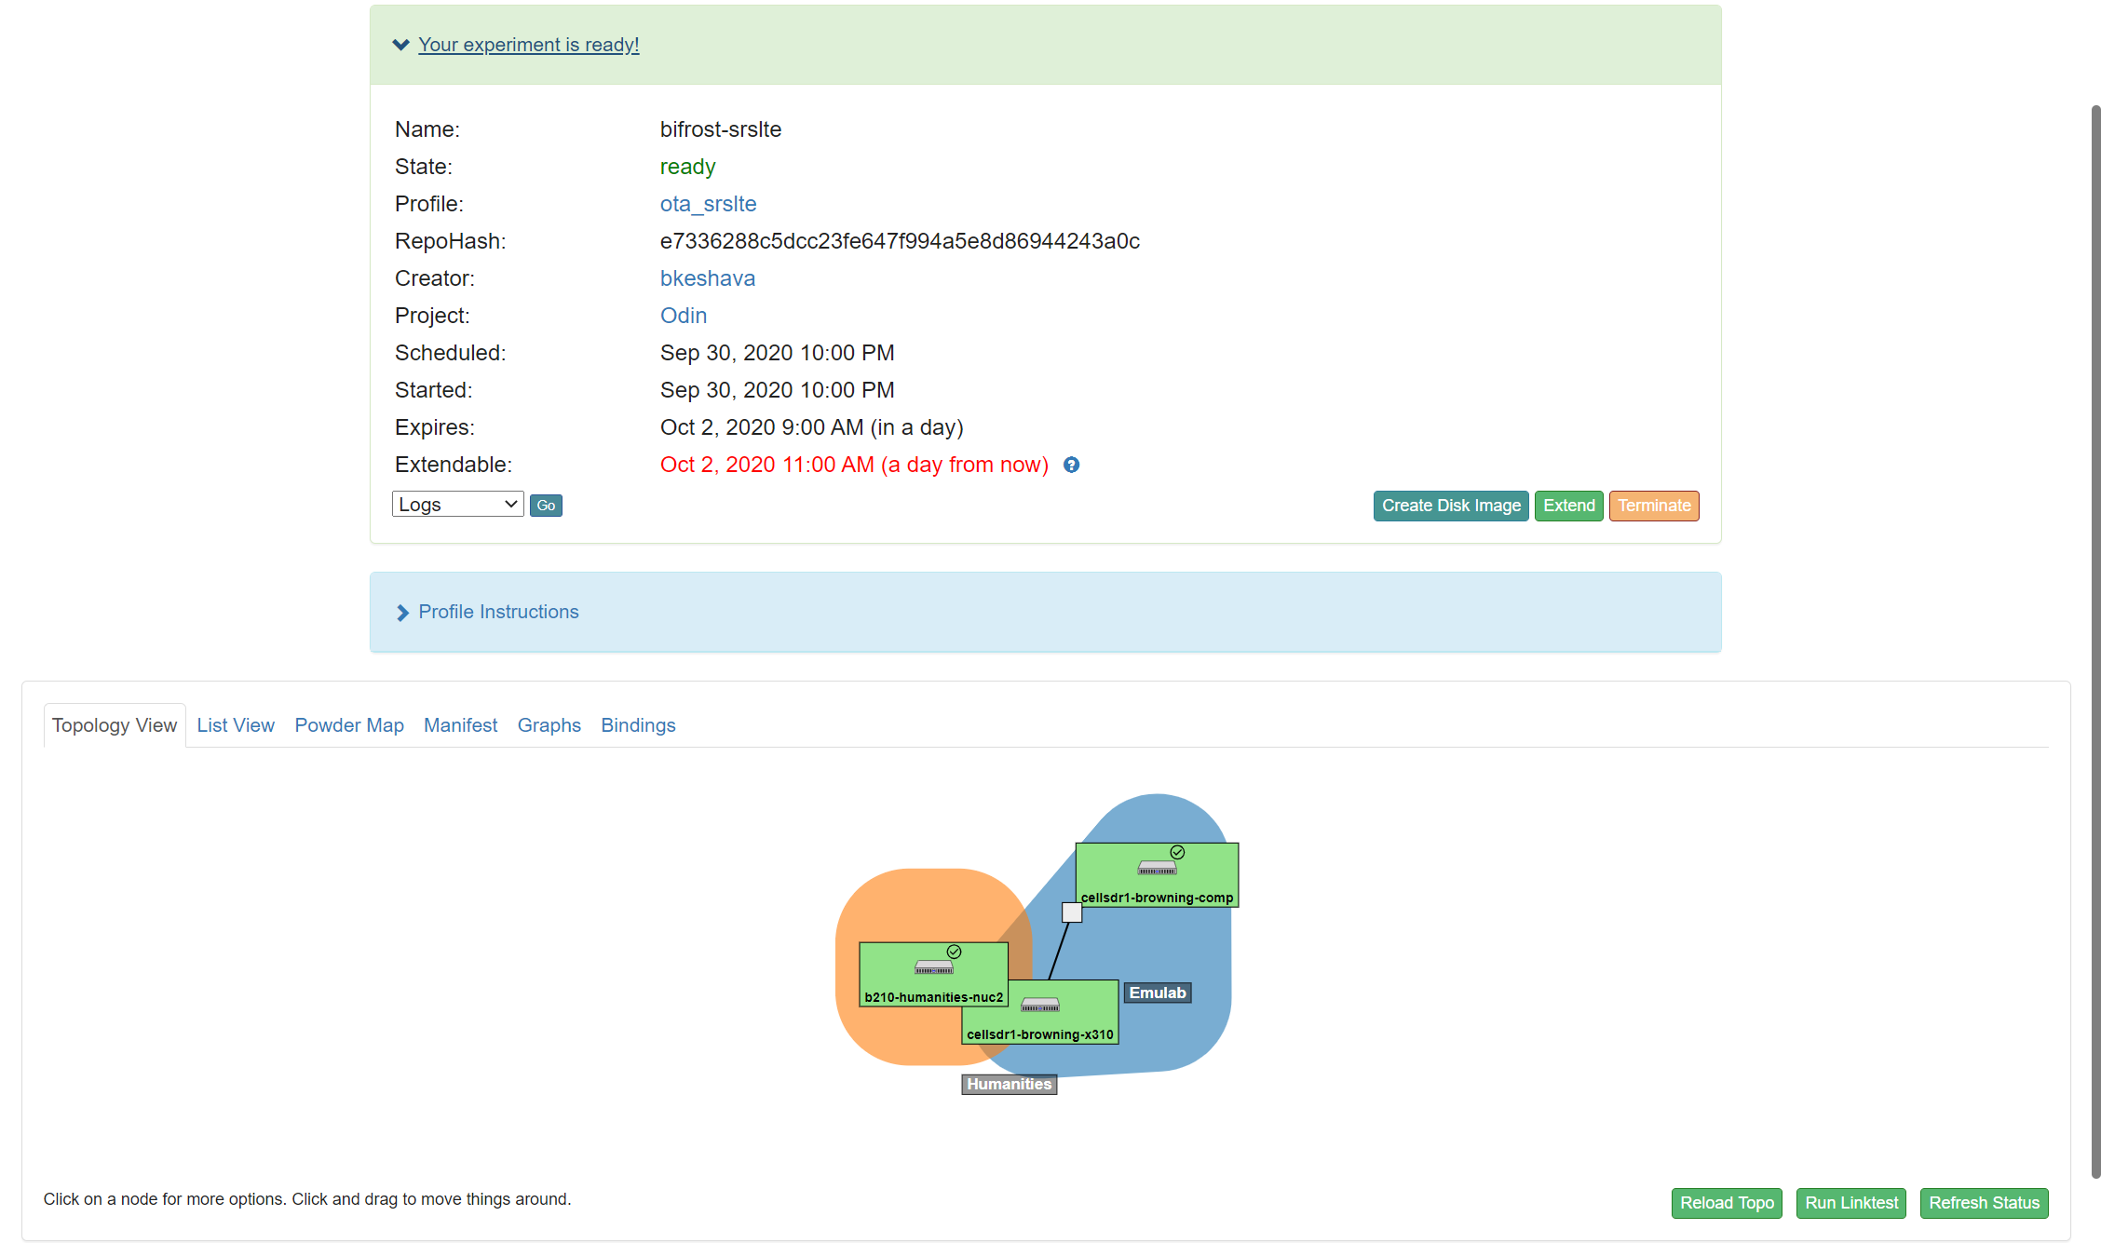
“ota_srslte”: Experiment setup and Topology
“ota_srslte” experiment profile
“ota_srslte” experiment schedule
Fixed-endpoint resource: USRP B210 & Intel NUC8i7BEH (nuc2 – USB 3.0) at the Humanities Building (human-height) with Channel A connected to a GSA.8841 antenna via a Band 7 FDD RF front-end
Downlink: 2620-2630 MHz
Uplink: 2500-2510 MHz
10Gbe link via an aggregation center
Channel A Tx/Rx and RX2 ports connected to the cellular port of a VVSSP-360S-F antenna via a Band-7 RF front-end facilitating FDD
Rooftop base-station resource at Browning: USRP X310 connected to a d740 Near-edge compute node

Slide 4
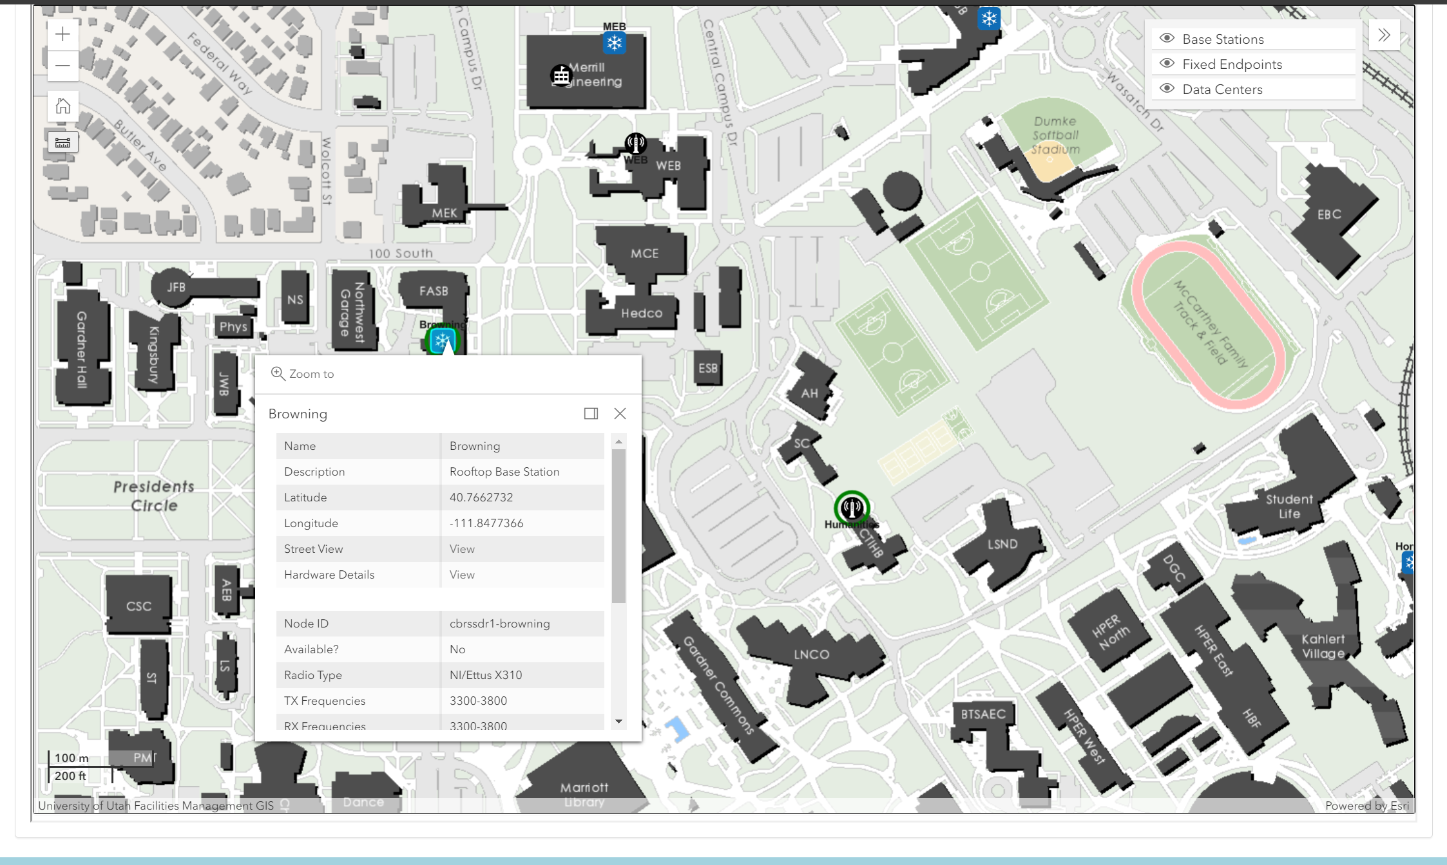
“ota_srslte”: Roof-top base-station resource at the Browning Building (eNodeB & EPC)

Slide 5
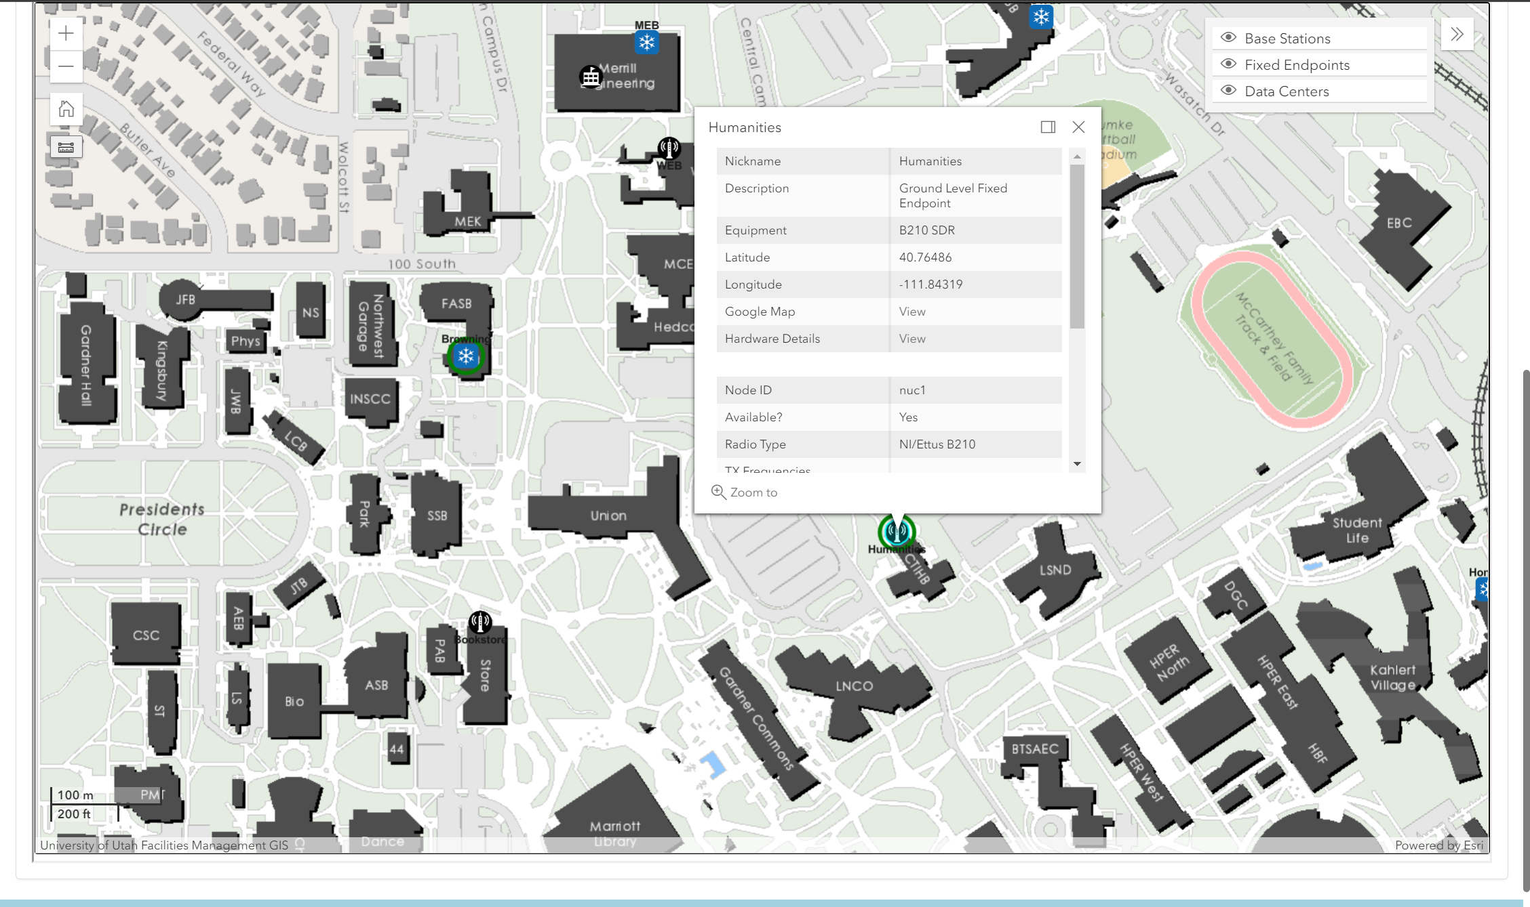
“ota_srslte”: Fixed-endpoint resource (UE) at the Humanities Building

Slide 6
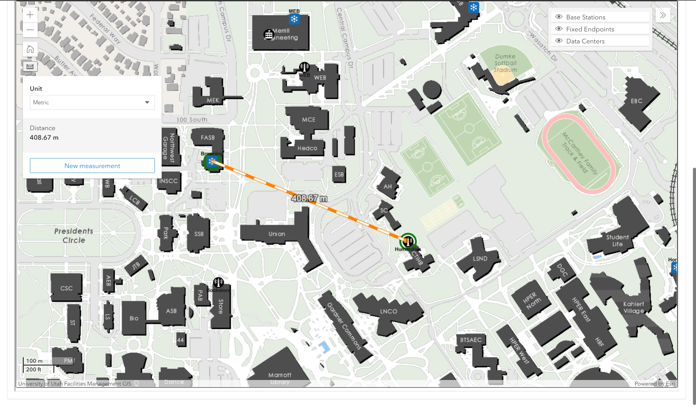
“ota_srslte”: Relative positions of the eNodeB and the UE on-campus (UofU)

Slide 7
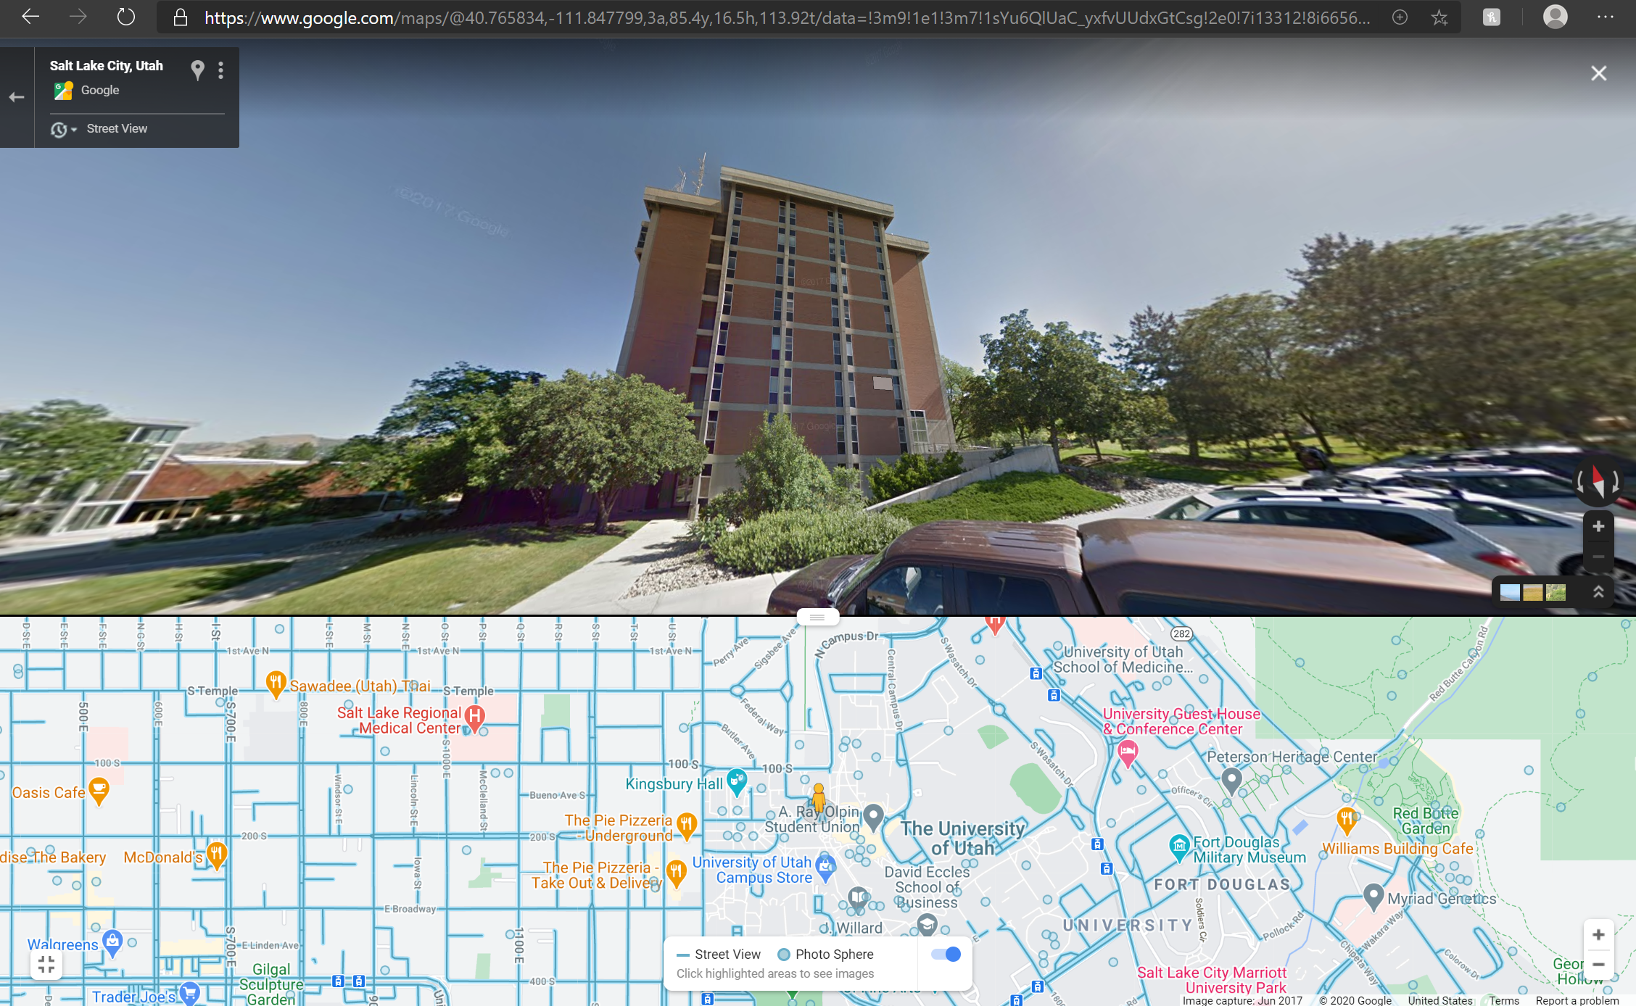
“ota_srslte” Street View: Roof-top base-station (eNodeB) installation at Browning
Humanities (UE)

Slide 8
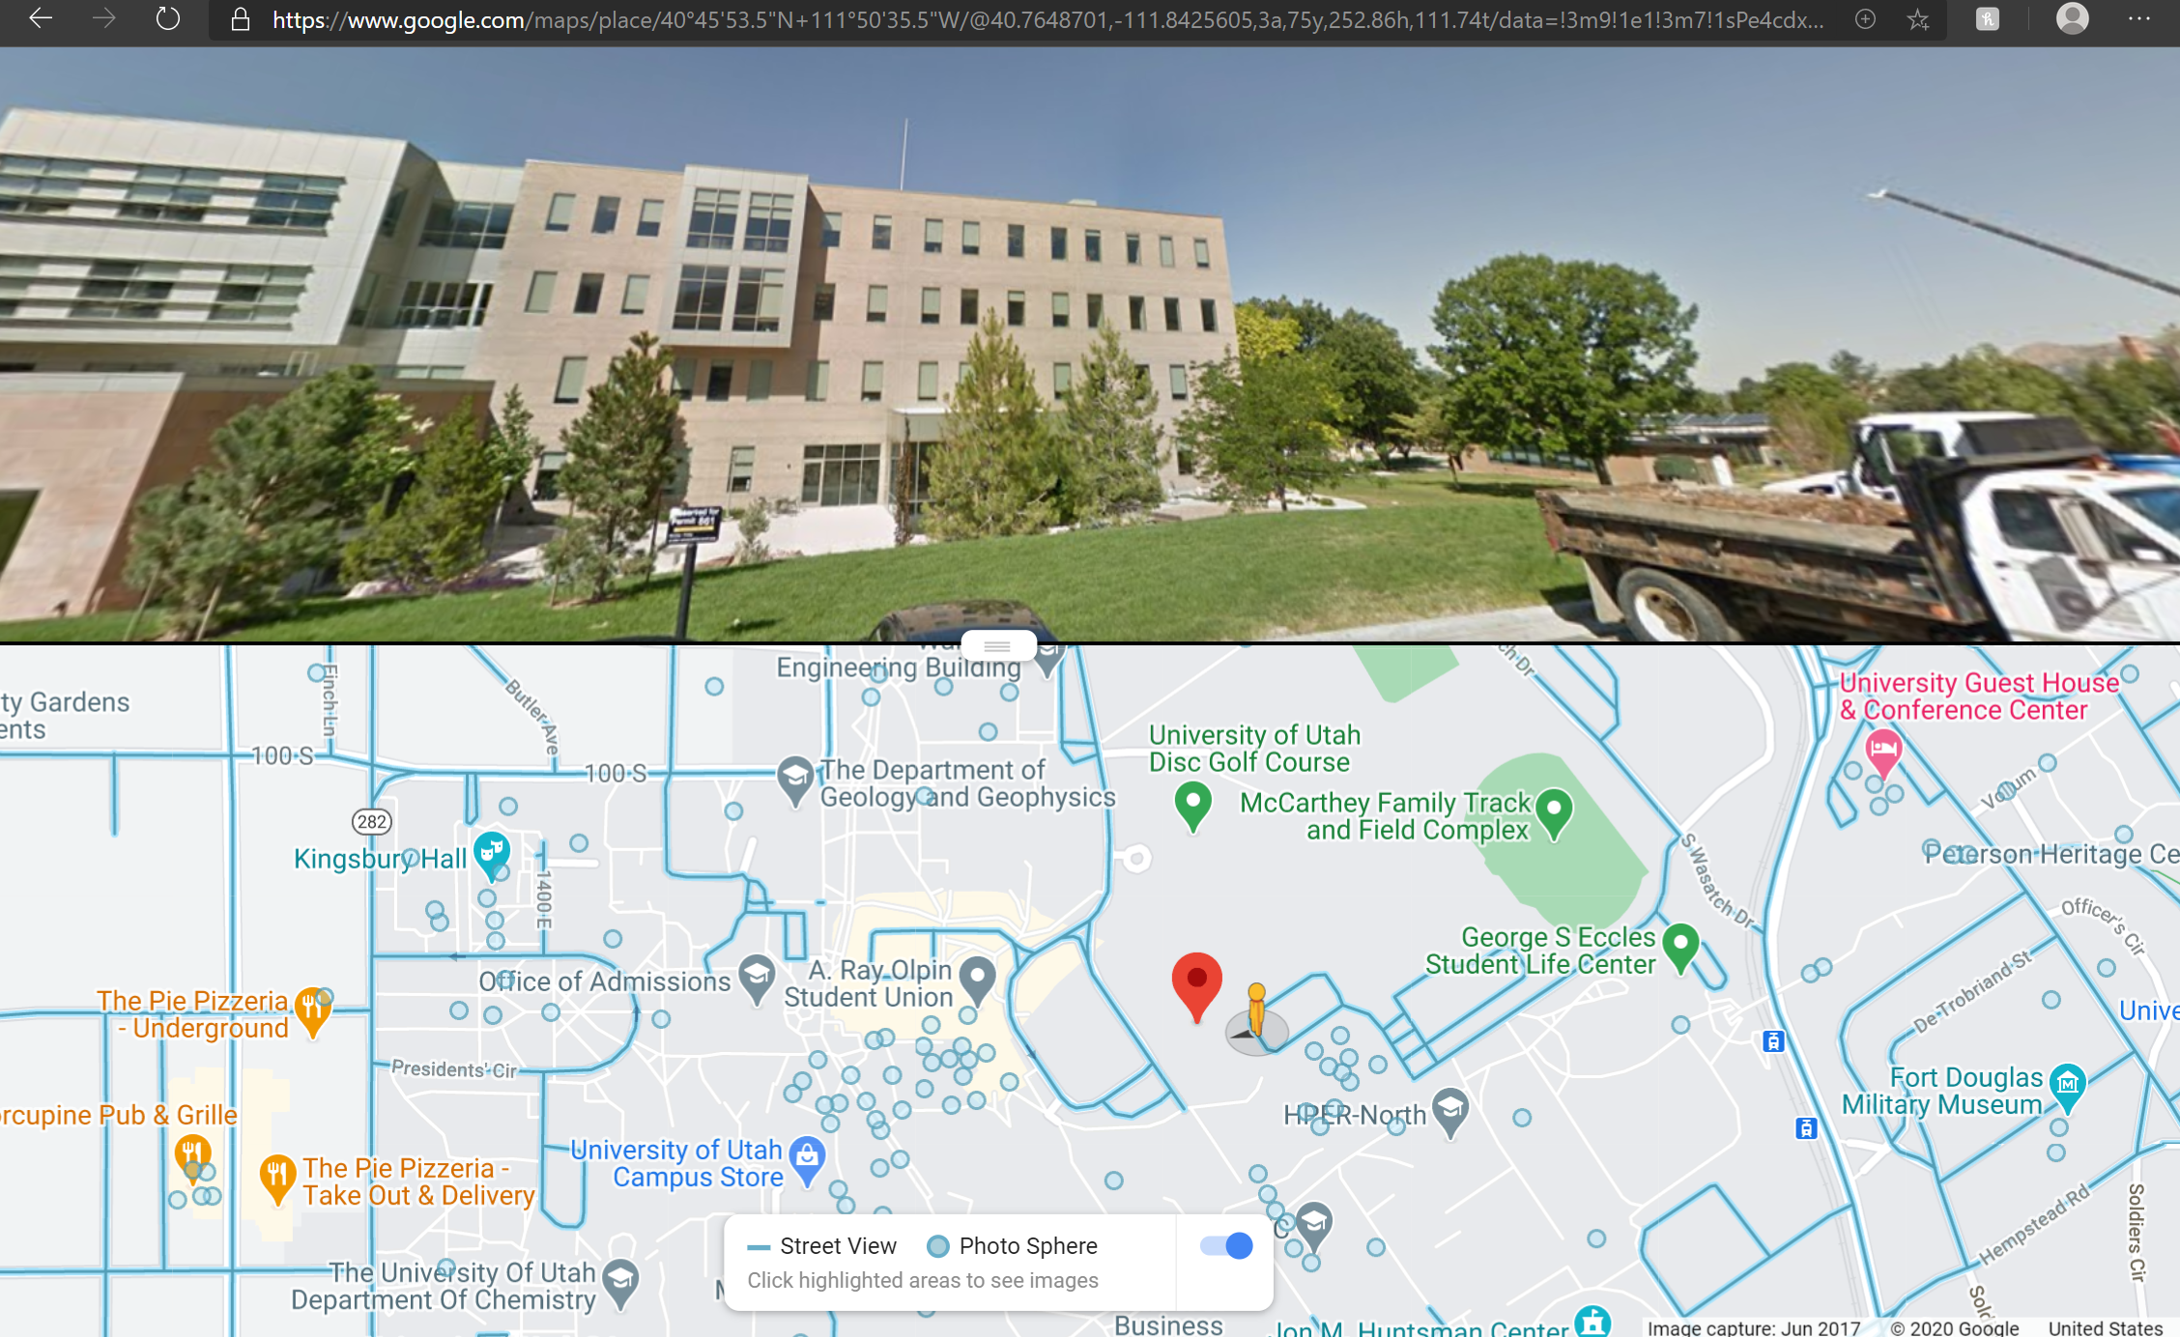
Browning (eNodeB)
“ota_srslte” Street View: Fixed-endpoint resource (UE) installation at Humanities

Slide 9
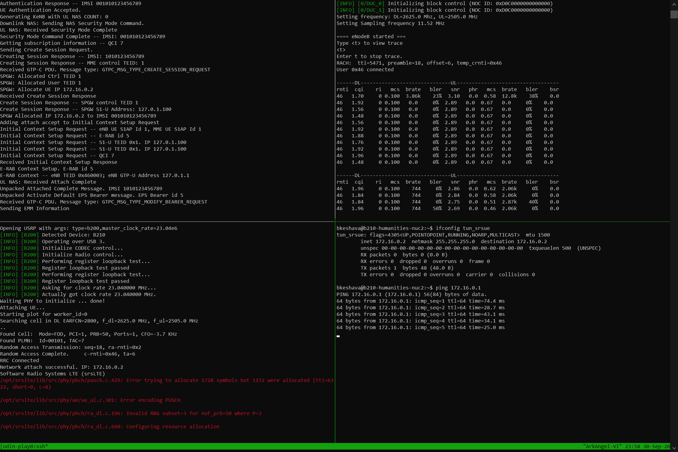
EPC Logs: Start HSS, Start MME, & Start SPGW; eNodeB Attach;
UE Authentication (via user_db.csv & epc.conf)
eNodeB Logs: Start DL at 2625 MHz;
Facilitate UE connection (UL: 2505 MHz);
[mme]
mme_code = 0x1a
mme_group = 0x0001
tac = 0x0007
mcc = 001
mnc = 01
mme_bind_addr = 127.0.1.100
apn = srsapn
dns_addr = 8.8.8.8
encryption_algo = EEA0
integrity_algo = EIA1
paging_timer = 2
[hss]
db_file = user_db.csv
[enb]
enb_id = 0x19B
cell_id = 0x01
phy_cell_id = 1
tac = 0x0007
mcc = 001
mnc = 01
mme_addr = 127.0.1.100
gtp_bind_addr = 127.0.1.1
s1c_bind_addr = 127.0.1.1
n_prb = 50
[rf]
dl_earfcn = 2800
tx_gain = 82
rx_gain = 43
ue1,xor,001010123456789,00112233445566778899aabbccddeeff,opc,63bfa50ee6523365ff14c1f45f88737d,9001,000000001234,7,dynamic
UE Logs: Radio (B210) Detection;
Compute Node Connection Check (USB3 to nuc2);
Cell Search Procedure (EARFCN = 2800);
RACH Tx; RRC Connection; Network Attach
[rf]
dl_earfcn = 2800
freq_offset = 0
tx_gain = 86
#rx_gain = 40 (AGC)
[usim]
mode = soft
algo = xor
k = 00112233445566778899aabbccddeeff
imsi = 001010123456789
imei = 353490069873319
UE Logs: Check for “tun_srsue” interface;
Ping SGi IP via the established LTE Network
“ota_srslte”: Console Logs at Startup

Slide 10
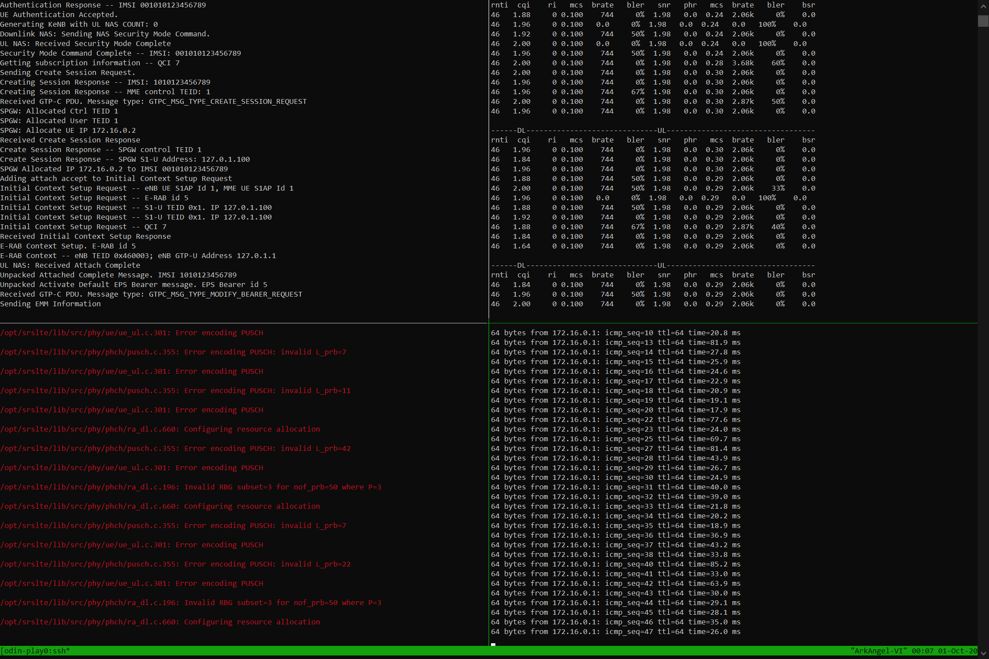
EPC Logs: eNodeB Attach - Done;
UE Authentication - Done
eNodeB Logs:
UL – RNTI | CQI | MCS | Bit Rate | BLER | SNR Metrics;
DL - RNTI | CQI | MCS | Bit Rate | BLER | SNR Metrics;
UE Logs: SGi Ping in-progress via the established LTE network
“ota_srslte”: Console Logs

Slide 11
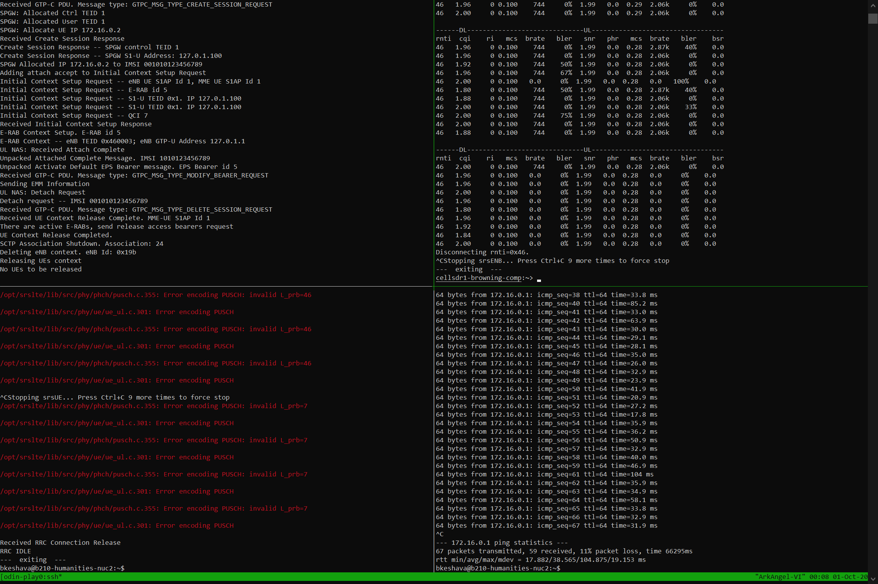
EPC Logs: UL NAS – Detach Request;
UE Context Release;
Delete eNodeB Context
eNodeB Logs: UE Disconnect; EPC Detach
UE Logs: Ping Final Statistics post-termination;
RRC Connection Release
“ota_srslte”: Console Logs at Clean-Up

Slide 12
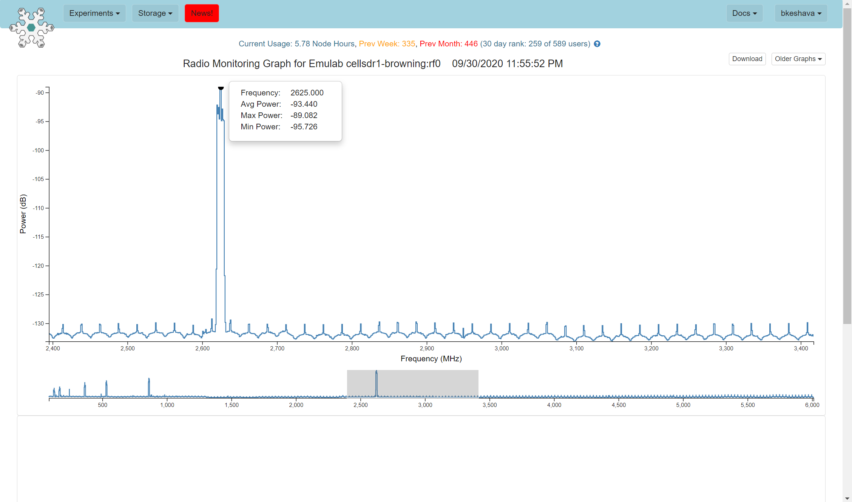
Browning (eNodeB) Radio Monitoring Graph: Downlink transmissions at 2625 MHz

Slide 13
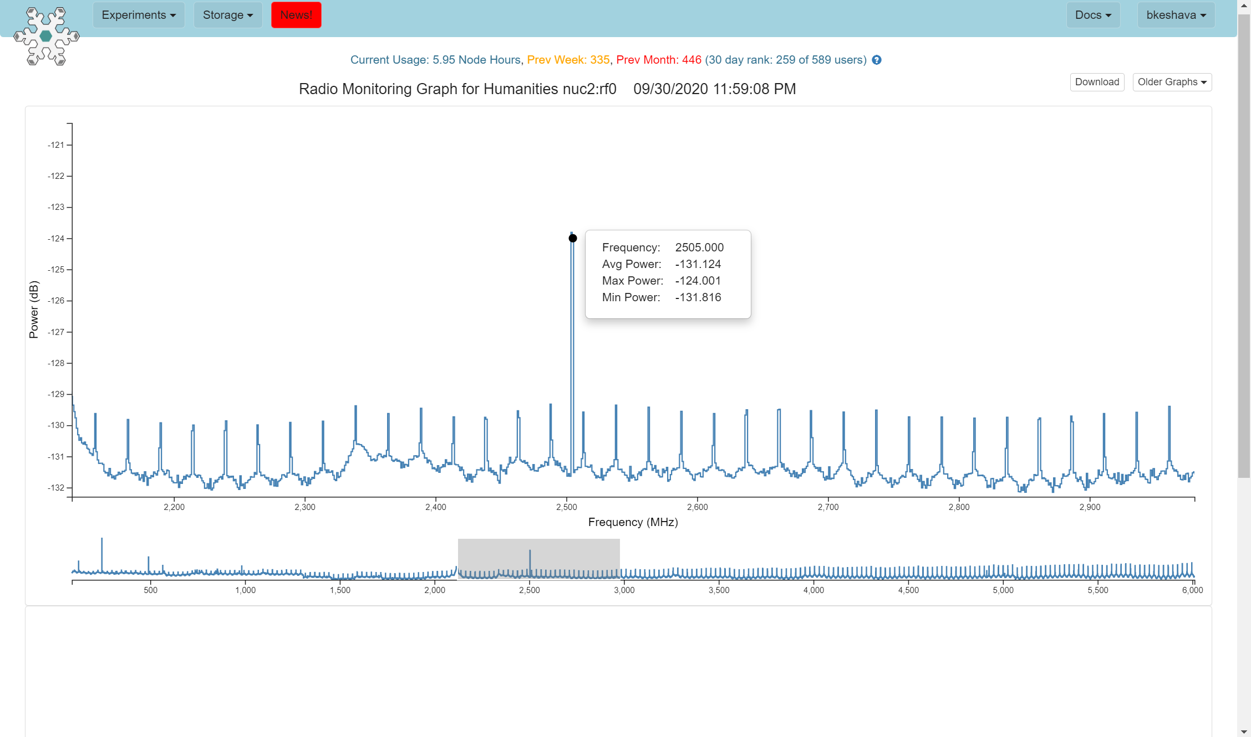
Humanities (UE) Radio Monitoring Graph: Uplink transmissions at 2505 MHz

Slide 14
Information about Node Radio Monitoring Graphs
Spectrum Compliance Monitoring System at POWDER
An extra USRP B210 at each site taps into the Tx lines of the user-allocatable radios
The associated monitoring software sweeps along taking PSD measurements
The PSD observations are then analyzed for compliance
Sources:
Kirk Webb (kwebb@cs.utah.edu)
Boston C. Terry, Alex Orange, Neal Patwari, Sneha Kasera, and Jacobus Van Der Merwe. 2020. Spectrum Monitoring and Source Separation in POWDER. In Proceedings of the 14th International Workshop on Wireless Network Testbeds, Experimental evaluation & Characterization (WiNTECH'20). Association for Computing Machinery, New York, NY, USA, 25–32. DOI:https://doi.org/10.1145/3411276.3412192

Slide 15
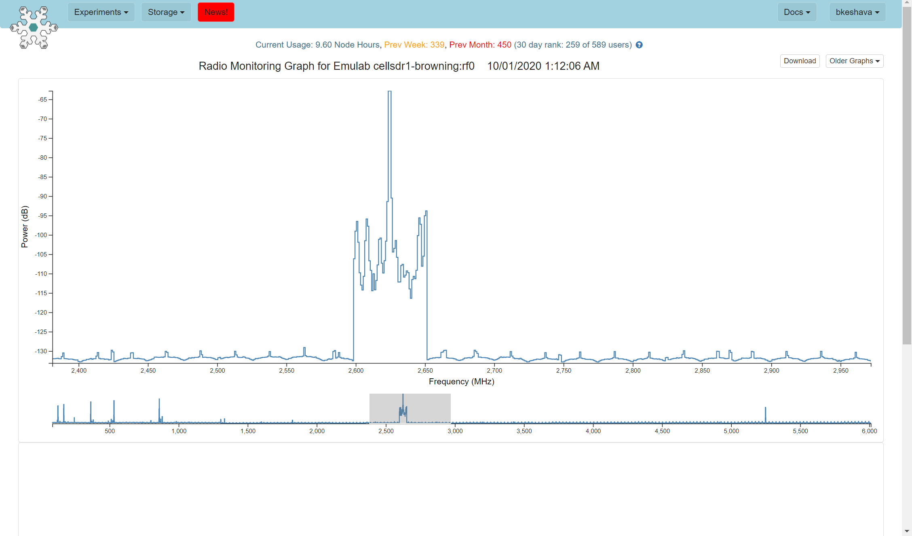
Example: Tx Frequency/Power Violation

Slide 16
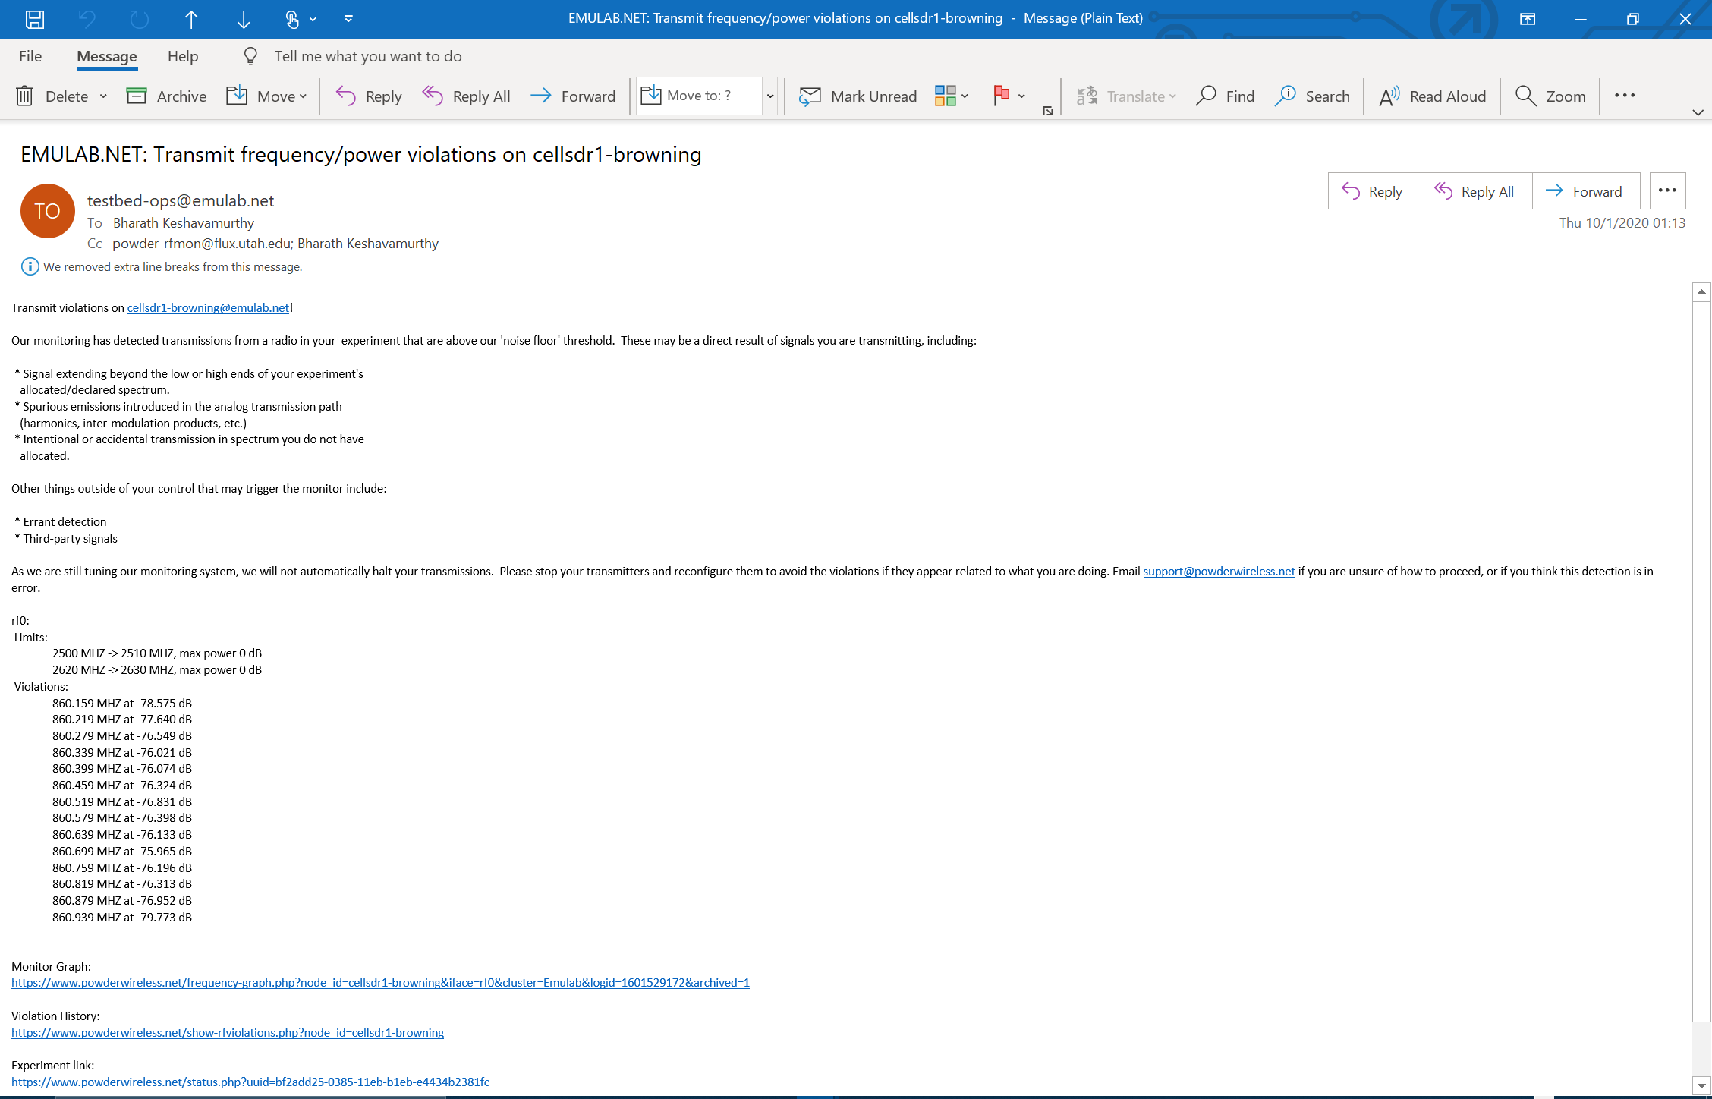
Tx Freq & Power Violation: Warning e-mail from the POWDER Spectrum Compliance Monitoring System
(Violation messages like these can be extracted in real-time via a REST/SOAP API)

Slide 17
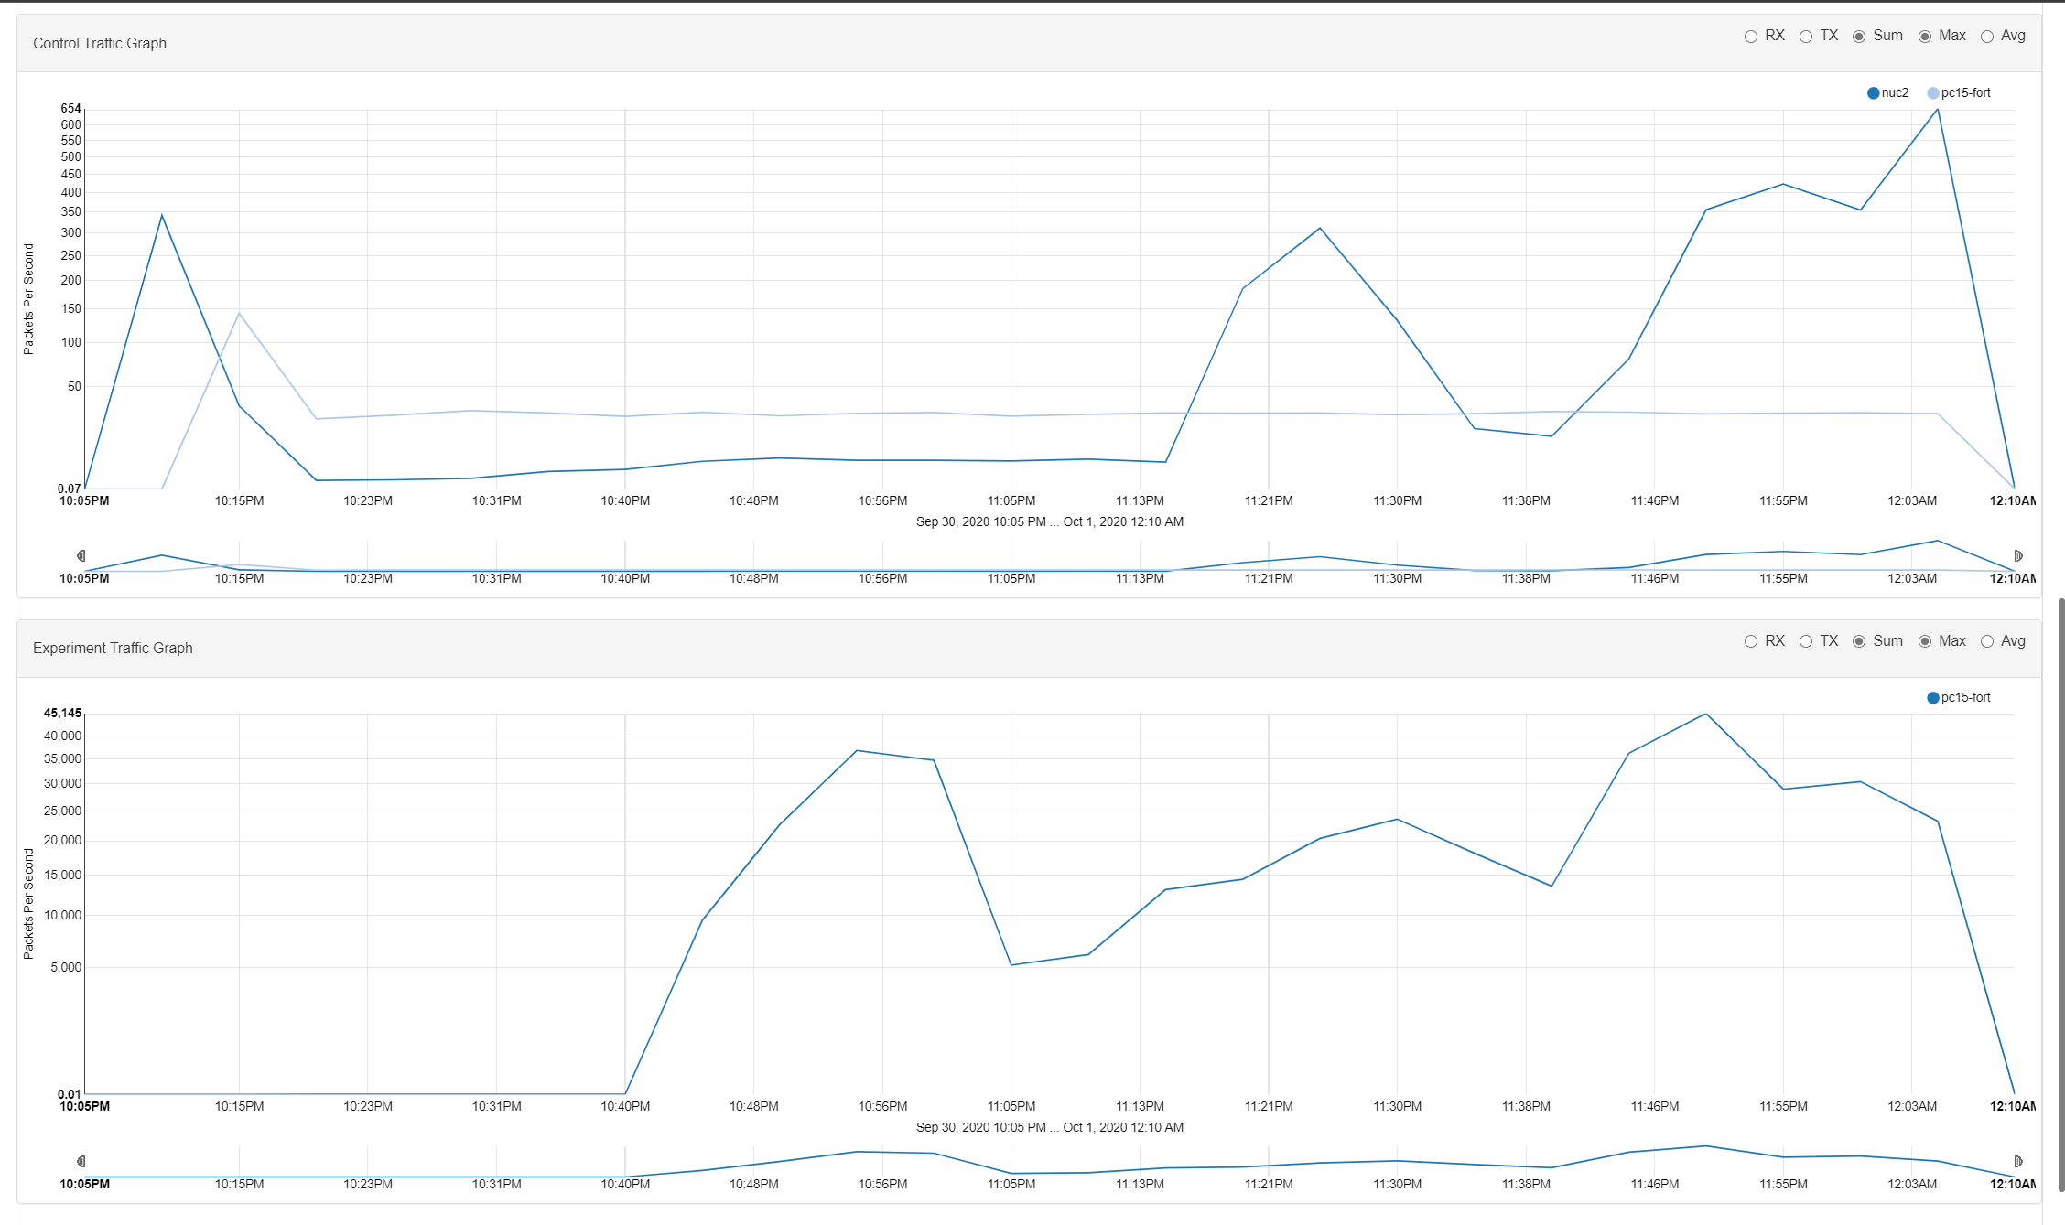
“ota_srslte” Traffic Plots: Packets Per Second v Time for both Radios
(eNodeB: X310 (cellsdr1-browning) & pc15-fort (d740))
(UE: B210 on nuc2 (humanities))

Slide 18
GNURadio Tx/Rx Over-The-Air (OTA)
Primary Open-Source Dependencies:
GNURadio
In-house Development:
POWDER experiment profile creation via public GitHub repositories
CBRS Spectrum, USRP radio & compute node provisioning via Python and geni-lib (profile.py)
Component startup shell scripts (startup.sh)
UHD image download & burn scripts
(x310-cbrssdr1-meb; x310-cbrssdr1-ustar)
OFDM PHY GNURadio Tx and Rx source code; PER Analyzer
(TX.grc; OFDM_TX.py; RX.grc; OFDM_RX.py; OFDM_TX_RX_1.py)
Configurations: Within the respective source files; input.log; output.log

Slide 19
GNURadio OFDM PHY Design
File Transfer [input.log (1.8 GB) AND tx.log (90 bytes)]
Tagged packet_len = 30 bytes; Trailing 4-byte CRC with packet_len update
QPSK for payload AND BPSK for header
64 OFDM sub-carriers
Cyclic Prefix with cp_len = 16
BW = 500kHz; Center Freq = 3555 MHz; UHD Sink (Tx/Rx port of cbrssdr1-meb-x310 with tx_gain = 31 dB)
UHD Source (Rx2 port of cbrssdr1-ustar-x310 with rx_gain = 36 dB)
Schimdl-Cox timing synchronization at the Rx

Slide 20
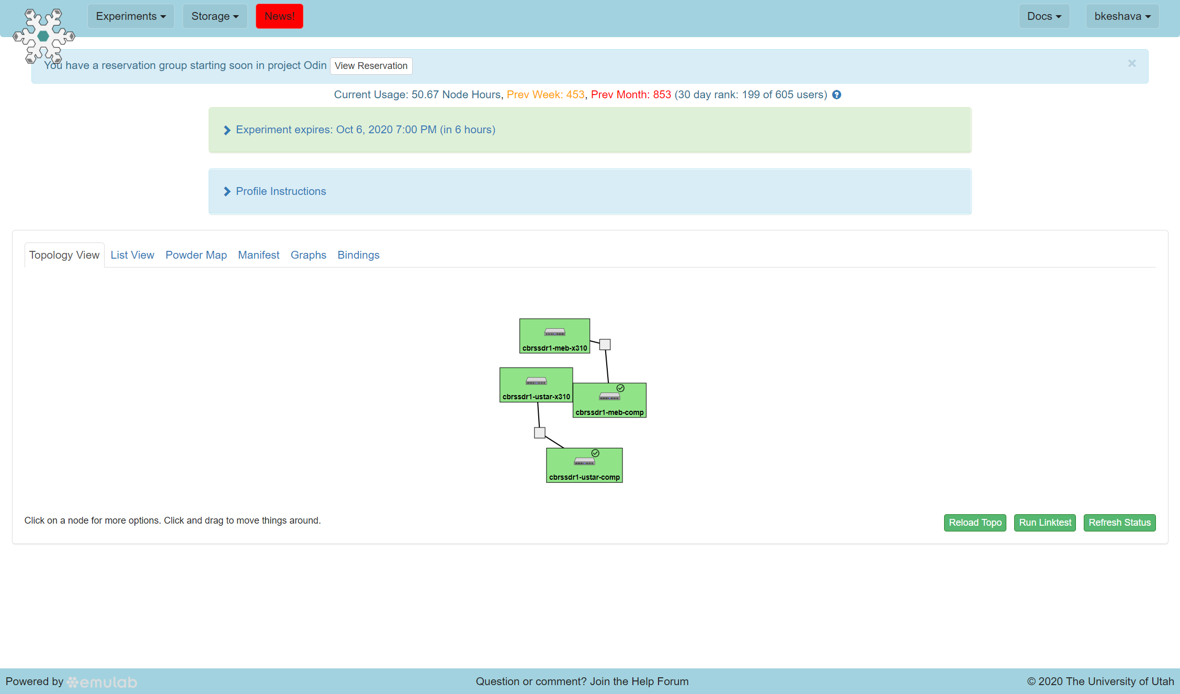
Rooftop base-station resource at MEB (Tx): USRP X310 connected to a d740 Near-edge compute node
Channel A Tx/Rx and RX2 ports connected to the CBRS port of a VVSSP-360S-F antenna
10Gbe link via an aggregation center
Channel A Tx/Rx and RX2 ports connected to the CBRS port of a VVSSP-360S-F antenna
Spectrum: 3550-3560 MHz
Tx/Rx Center Freq: 3555 MHz
Bandwidth for GNURadio File Transfer: 500 kHz
10Gbe link via an aggregation center
Rooftop base-station resource at USTAR (Rx): USRP X310 connected to a d740 Near-edge compute node
OTA GNURadio: Experiment setup and Topology

Slide 21
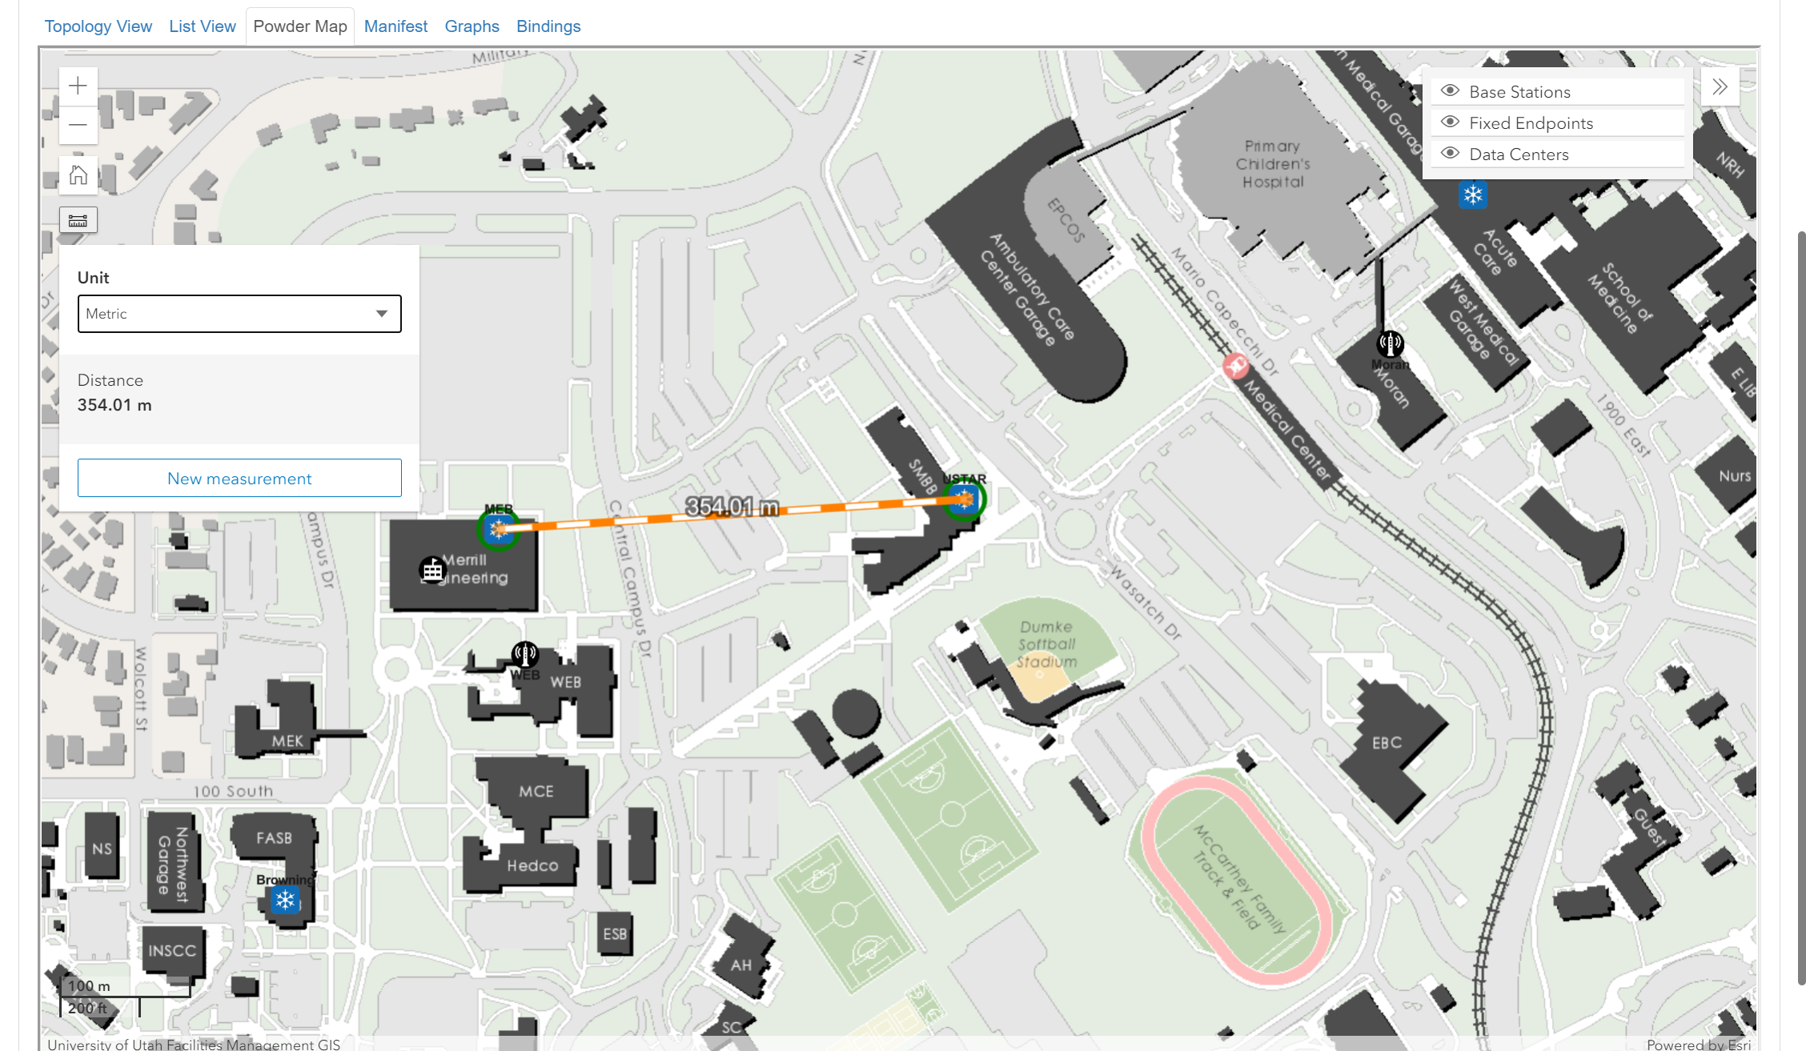
OTA GNURadio: Relative positions of the Tx (MEB) and the Rx (USTAR) on-campus (UofU)

Slide 22
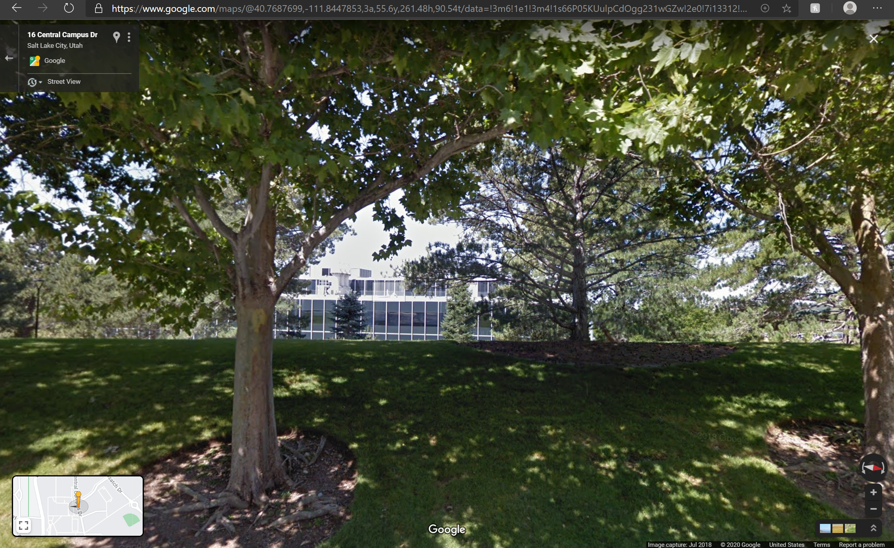
OTA GNURadio Street View: Roof-top base-station (Tx) Installation at the
Merrill Engineering Building (MEB)

Slide 23
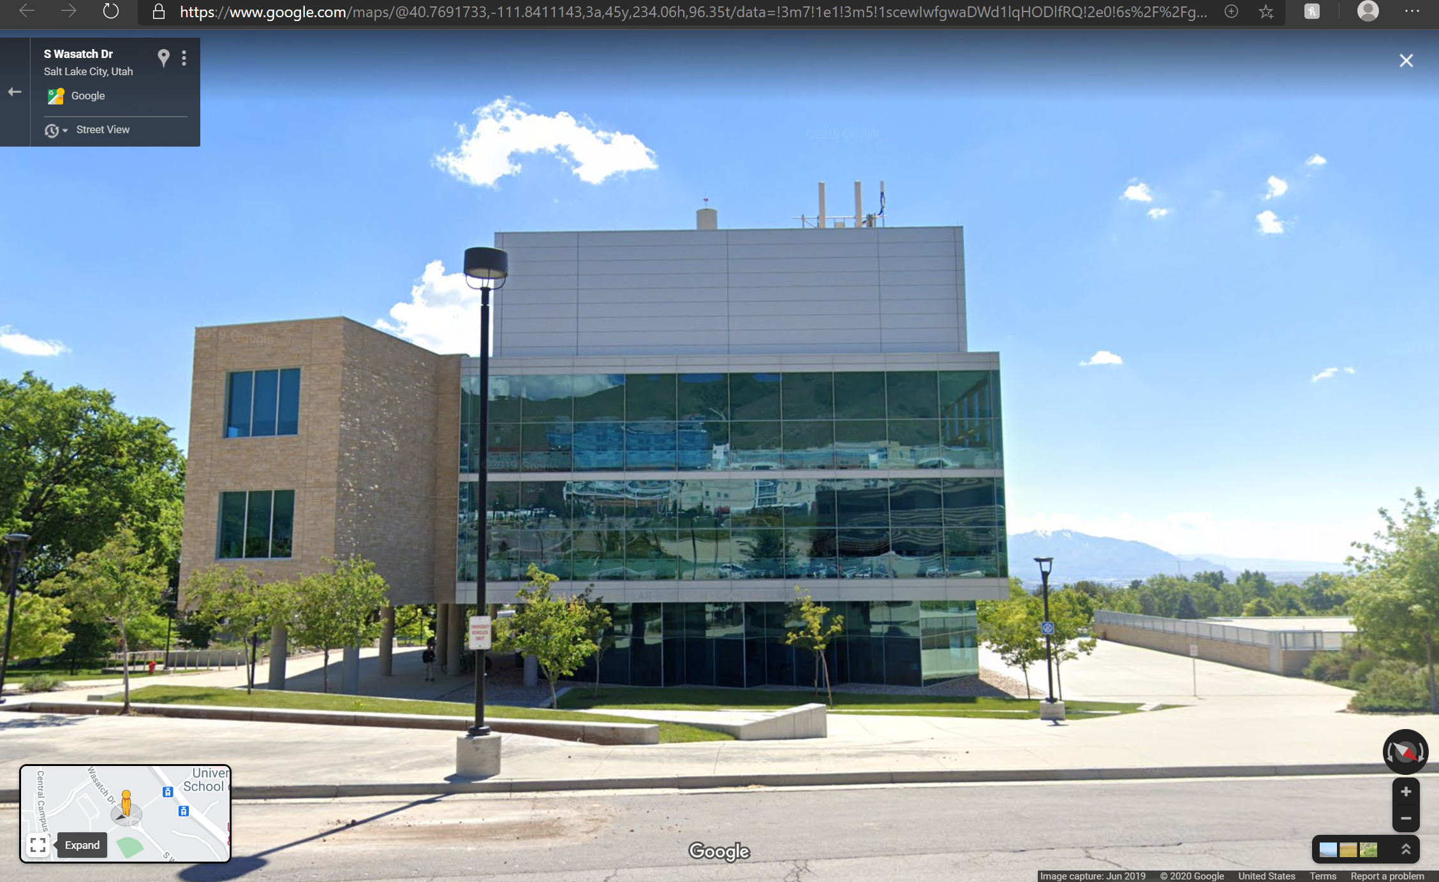
OTA GNURadio Street View: Roof-top base-station (Rx) Installation at USTAR

Slide 24
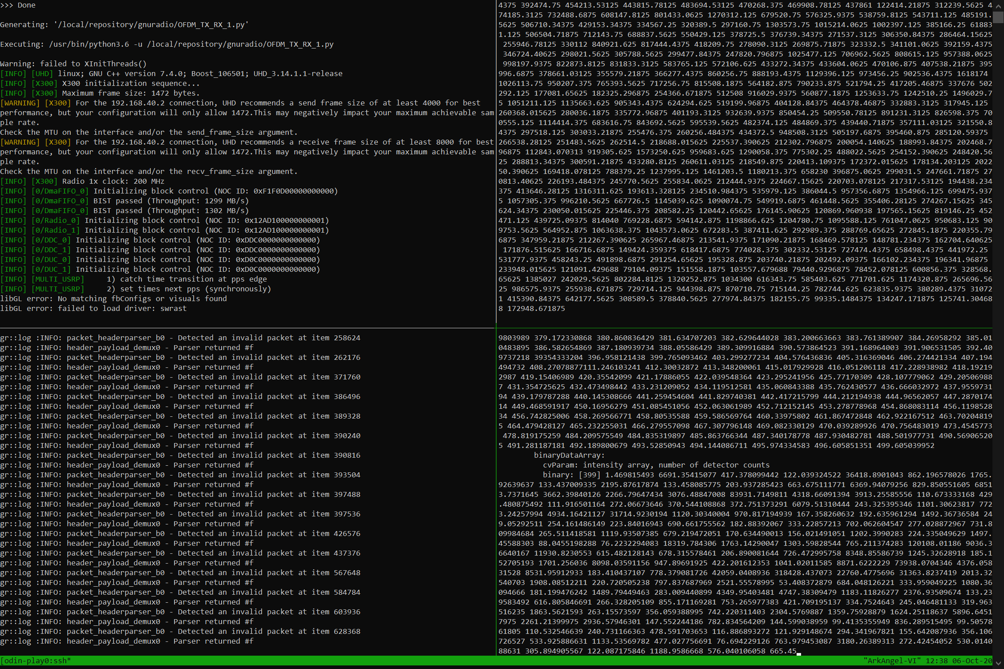
MEB: Tx.grc logs
File Contents being transmitted: input.log (1.8 GB)
File Contents being received: output.log
USTAR: Rx.grc logs
OTA GNURadio: Console Logs at Startup

Slide 25
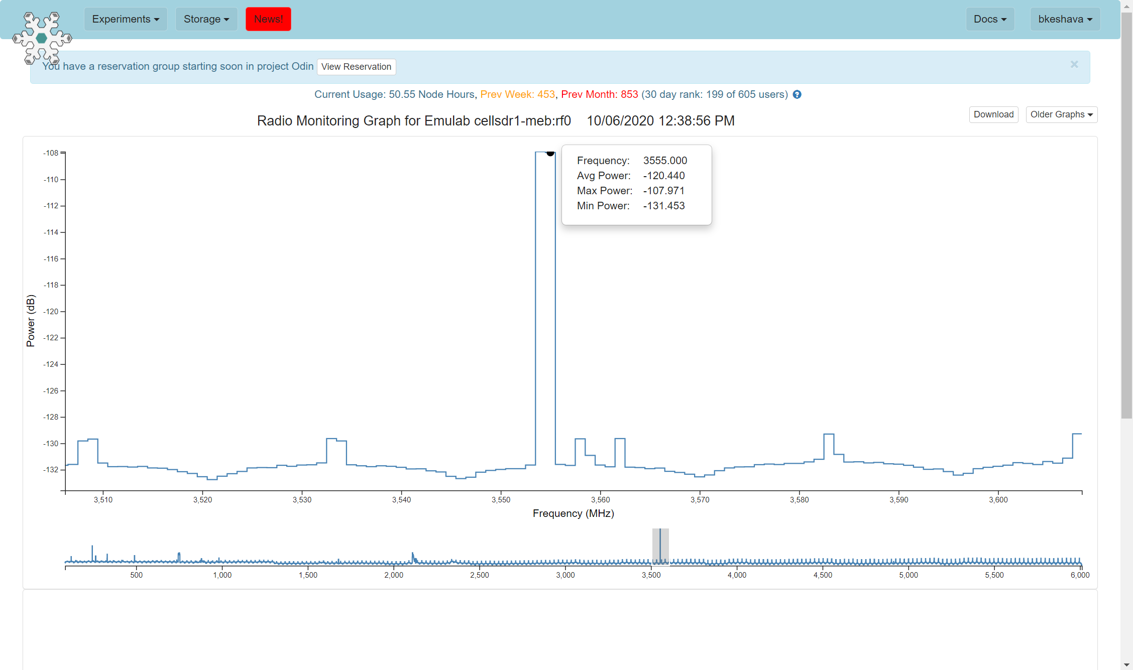
MEB (Tx) Radio Monitoring Graph: Transmission at 3555 MHz

Slide 26
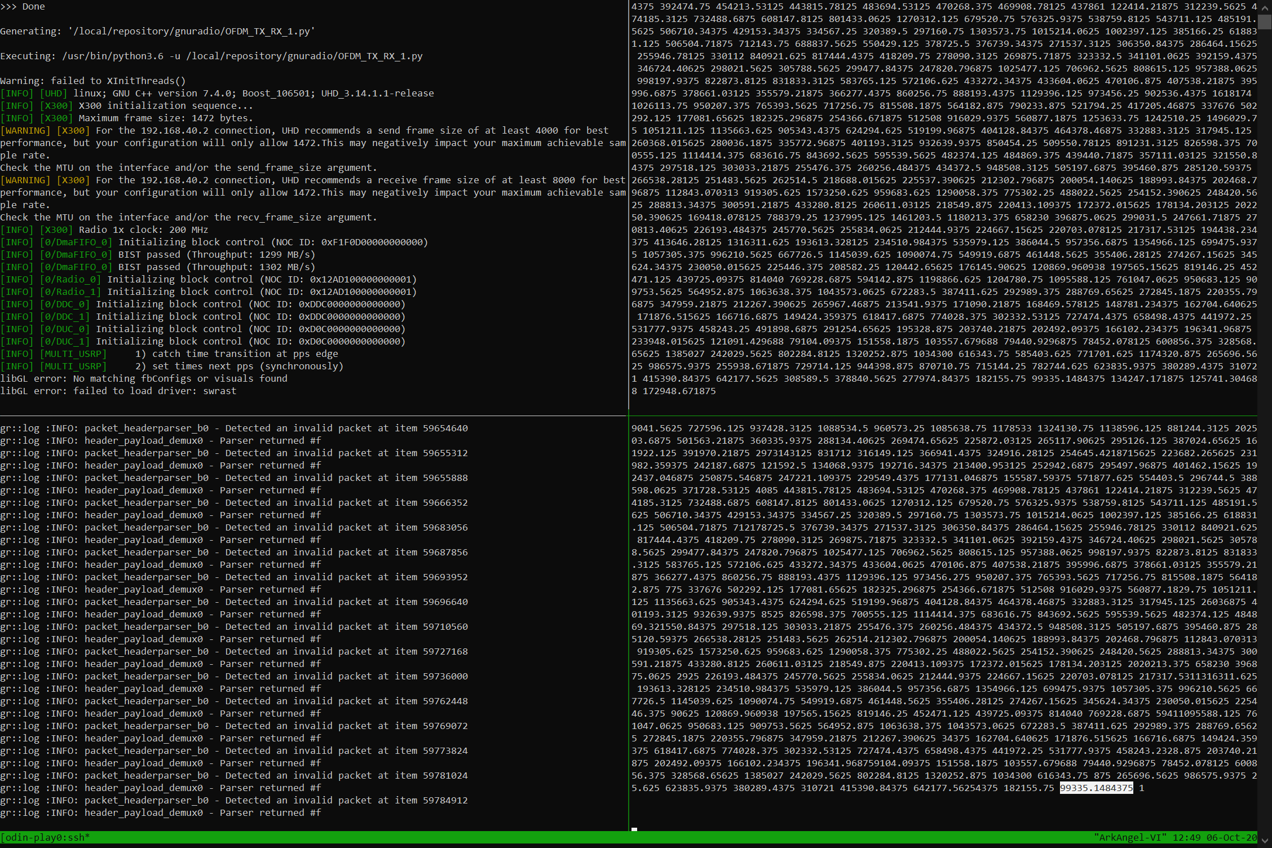
MEB: Tx.grc logs
OTA GNURadio: Console Logs at Completion
File Contents Tx (input.log) Completed
USTAR: Rx.grc logs
File Contents Rx (output.log) Completed

Slide 27
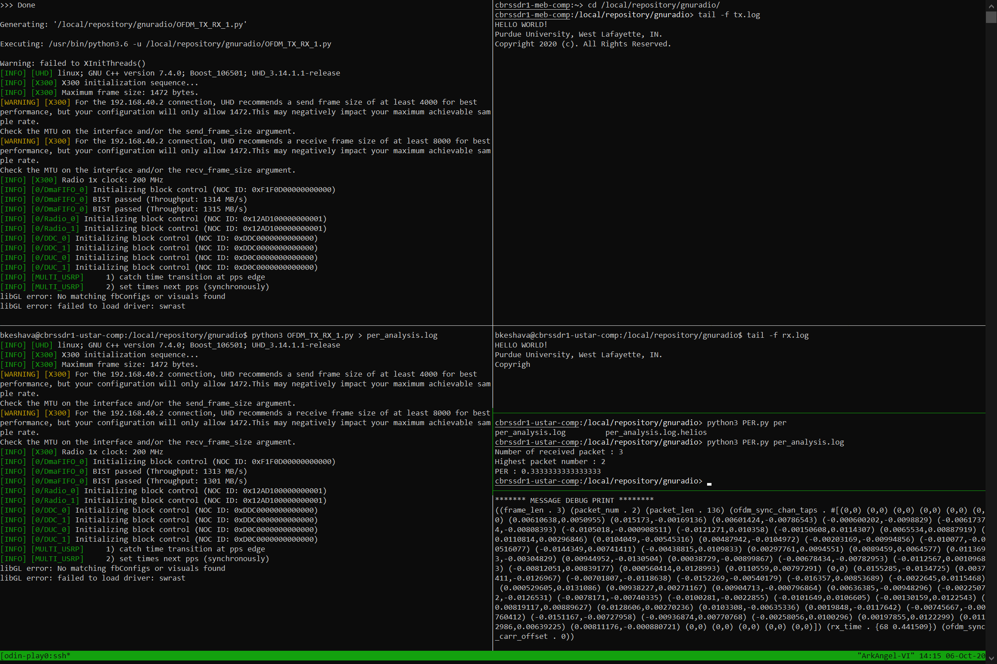
File Contents being transmitted: tx.log (3 packets = 90 bytes)
packet_length = 30
OTA GNURadio: PER Analysis Console Logs
MEB: Tx.grc logs for a simple file
File Contents received: rx.log (2 packets received correctly; 1 in error)
PER Analysis: 33% PER (1 packet lost)
USTAR: Rx.grc logs for a simple file
GNURadio PER Analysis (header info) Message Debug block

Slide 28
BAM! Wireless Radio on POWDER
Design changes
Disable CIL Client-Server Tx/Rx AND P2P Tx/Rx
Disable C2API (The SC2 Colosseum Interface)
Lack of CUDA-capable GPU on NEC/Emulab/On-site CloudLab:
Replace GPUFFT.cu (cuFFT) with a GNURadio FFT block “implementing” the FFT.h interface
Replace sc_sync.cu (Schimdl-Cox sync) with a GNURadio Schmidl-Cox Synchronization block
Replace gpu.cu (Carrier De-mapping based on a serialization plan) with a GNURadio OFDM Serializer block (both header & payload)
Replace channelizer2.cu (k_mix(), k_filter(), k_discard(), and k_decimate() “kernel calls”) with a USRP UHD Source block
All the above replacements are integrated with the phy.cc root source call
Testing: In progress

Slide 29
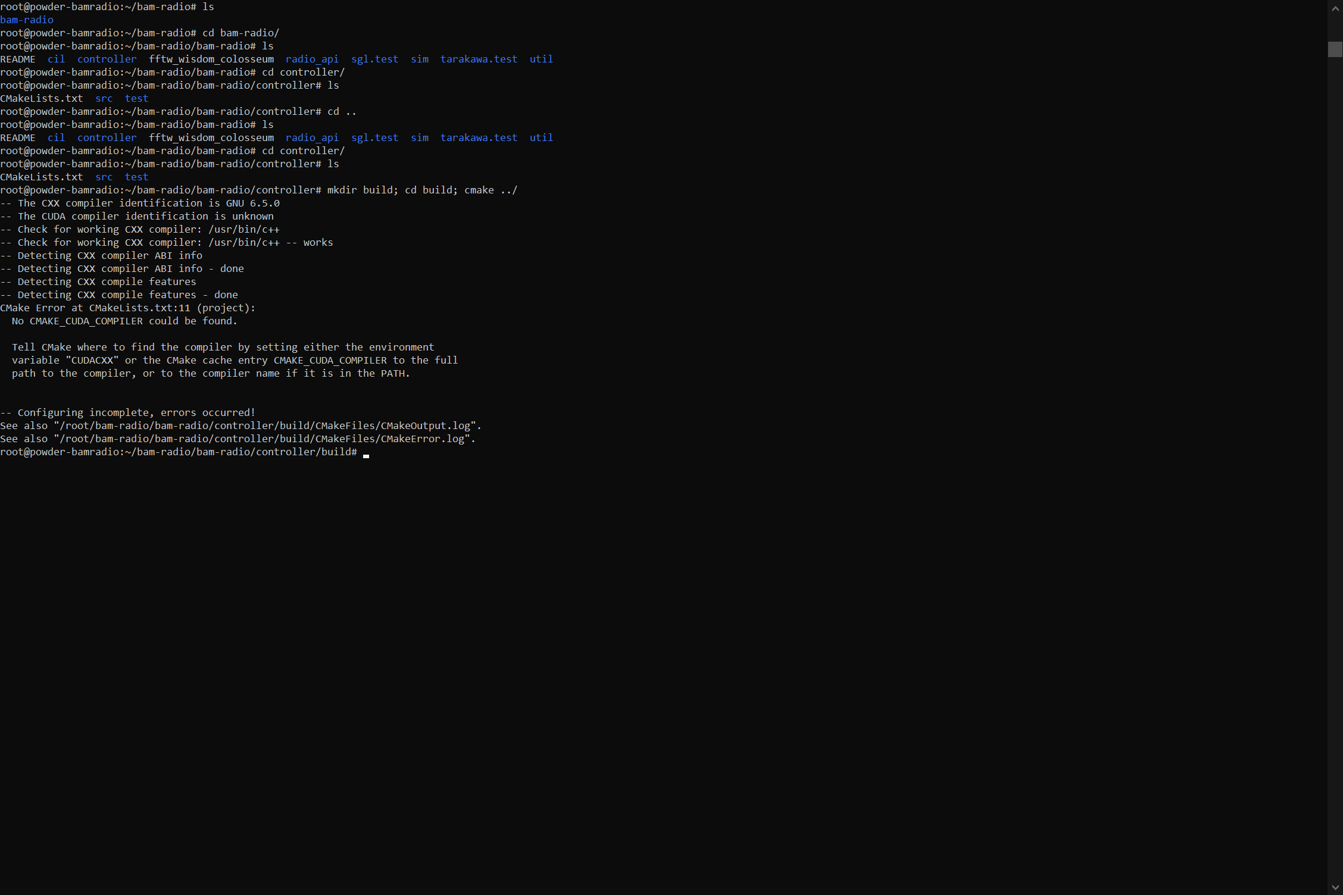
CUDA Compilation Failure: No CUDA-compatible GPU

Slide 30
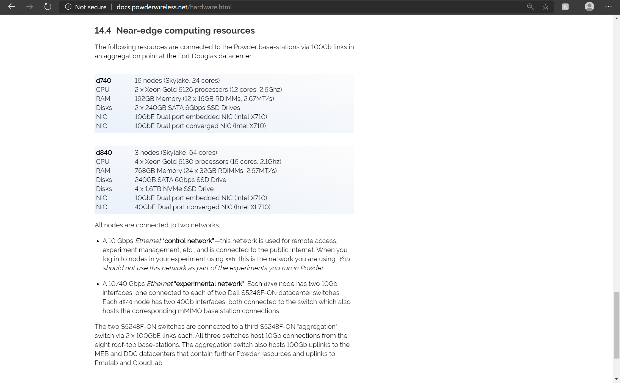
No CUDA-compatible GPU
Utah Emulab Near-Edge Computation Resources

Slide 31
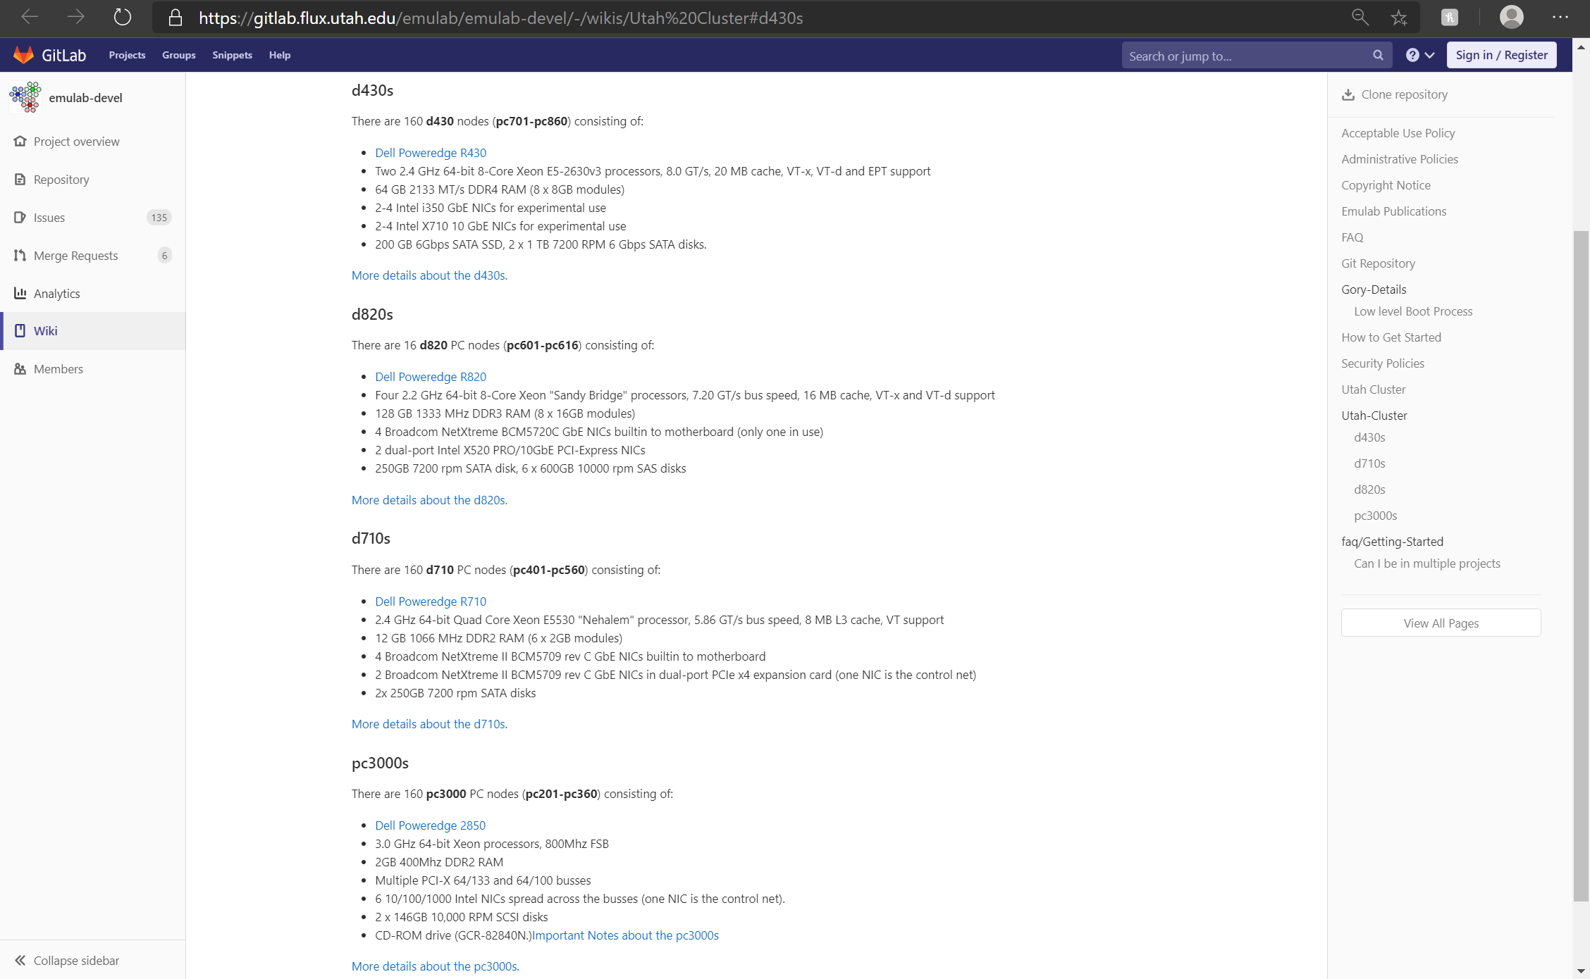
No CUDA-compatible GPU
Utah CloudLab Computation Resources

Slide 32
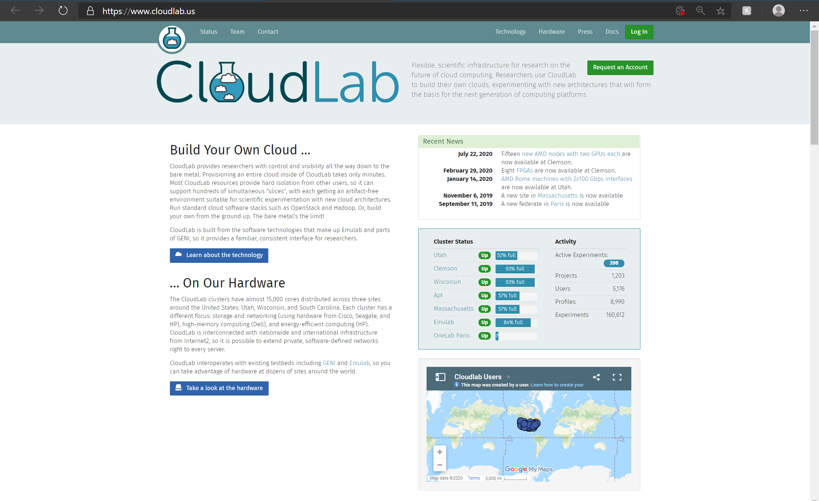
Federated CloudLab Computation Resources

Slide 33
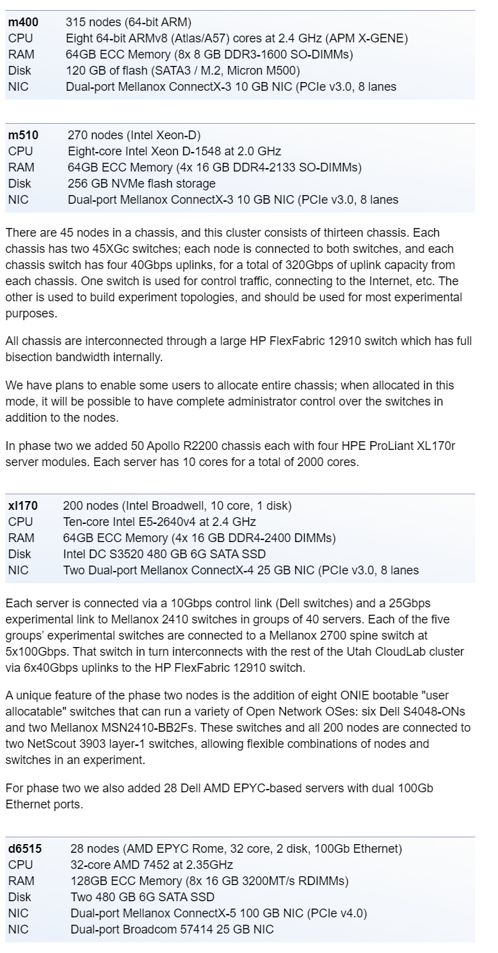
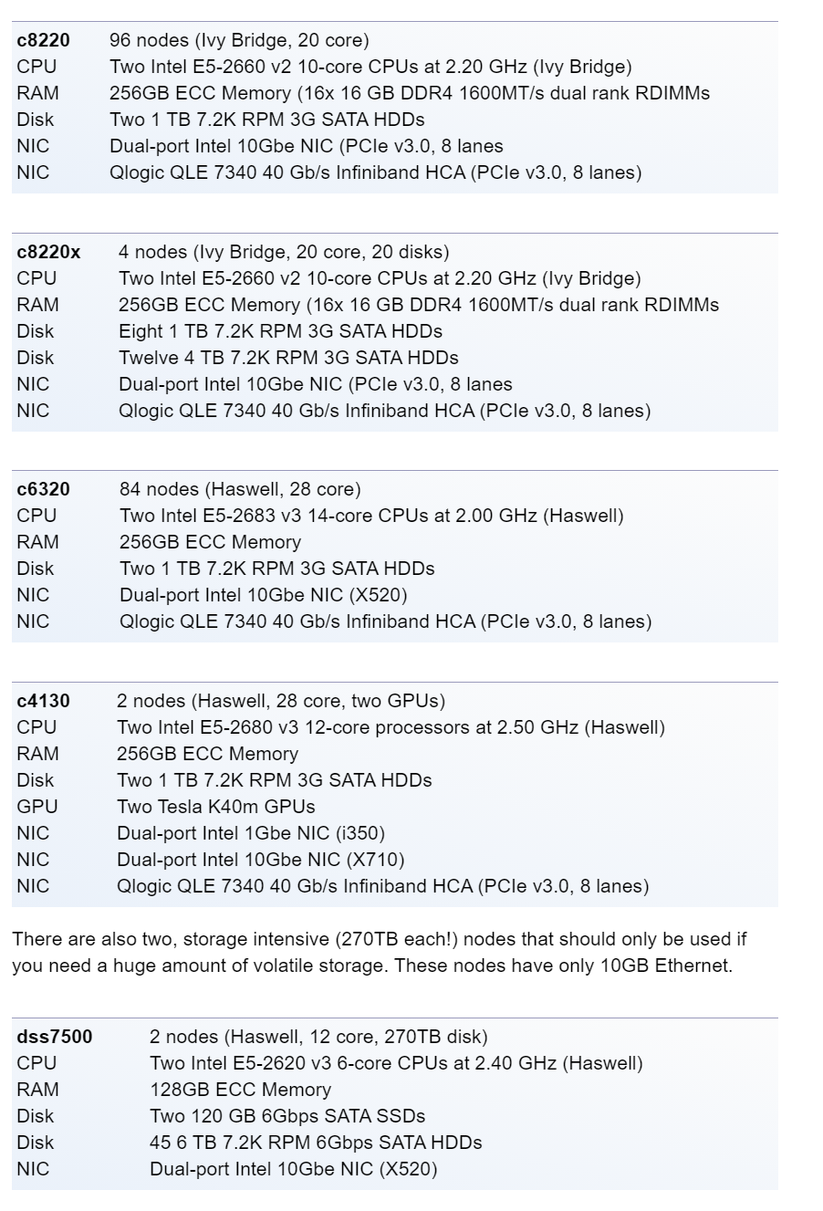
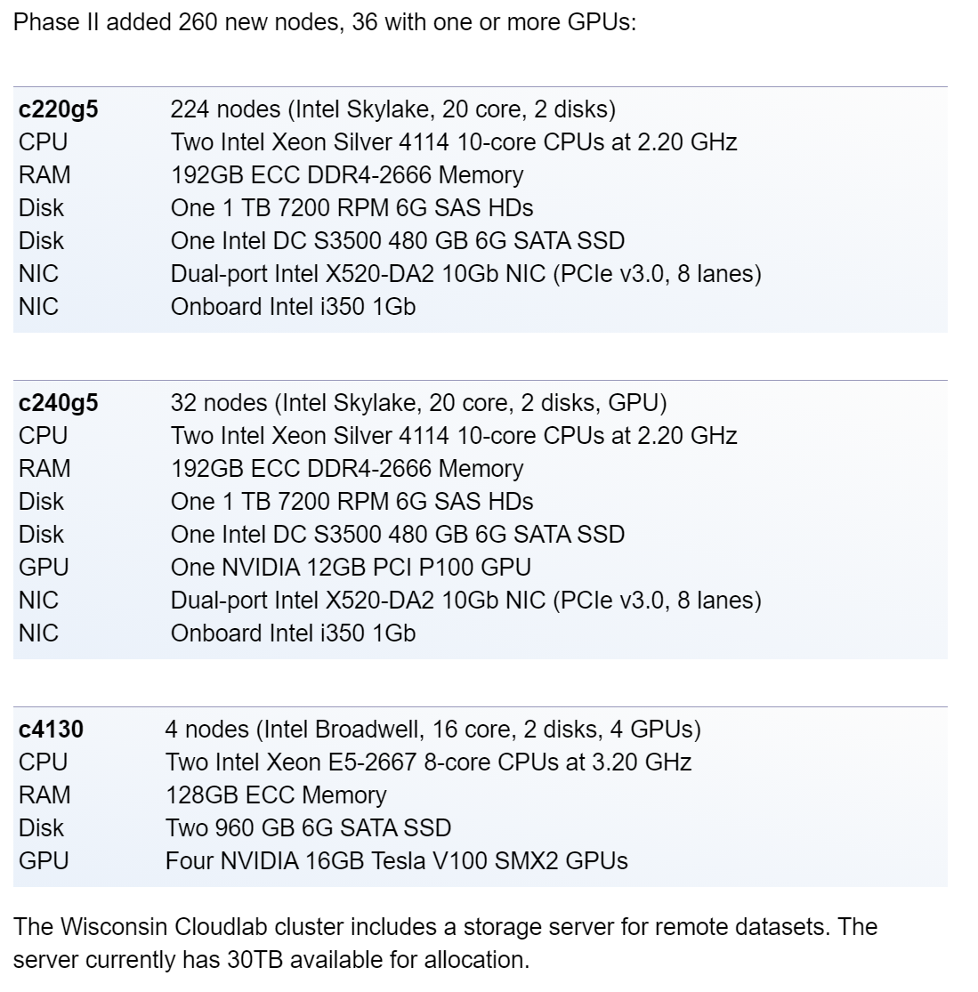
Utah CloudLab
UWisconsin CloudLab
Clemson CloudLab
CUDA-compatible NVIDIA Tesla K40m (2880 CUDA cores) with 12GB GDDR5 RAM)
CUDA-compatible NVIDIA Tesla V100 (5120 CUDA cores) with 16GB HBM2 RAM)
These sites are not accessible from the POWDER test-bed; Off-site channelizer and sc_sync processing has high-latencies; Untenable; Changes to the radio’s design are better alternatives

Slide 34
Other Tasks in Progress
Incumbents in the network: BAM! Wireless radio performance in the following SC2 scenarios re-created with actual OTA Tx/Rx in the CBRS spectrum:
“Passive Incumbent” – Violation messages obtained from the spectrum compliance monitoring system via REST/SOAP
“Active Incumbent” – Predefined patterns in occupancy behavior via a configuration file
Test channel sensing & access algorithms in these scenarios (POMDP, DQNs, TD-SARSA)
Post-processing analyses via the already developed PyQt5 Analyzer GUI (SQLite DBs)
Data collection experiments on the Skylark Wireless Massive MIMO equipment (64x64 chains at the central hub, 4x10Gbe backhaul, Dell d840 “Big Iron” compute) at Merrill Engineering Building
32 IRIS-030-D 2x2 transceiver radios with BRS and CBRS front-ends
FAROS-ENC-05-HUB aggregation hub (4x4 + 2x8 = 32 IRIS devices)
Provisioning mobile end-points on POWDER for data collection

Slide 35
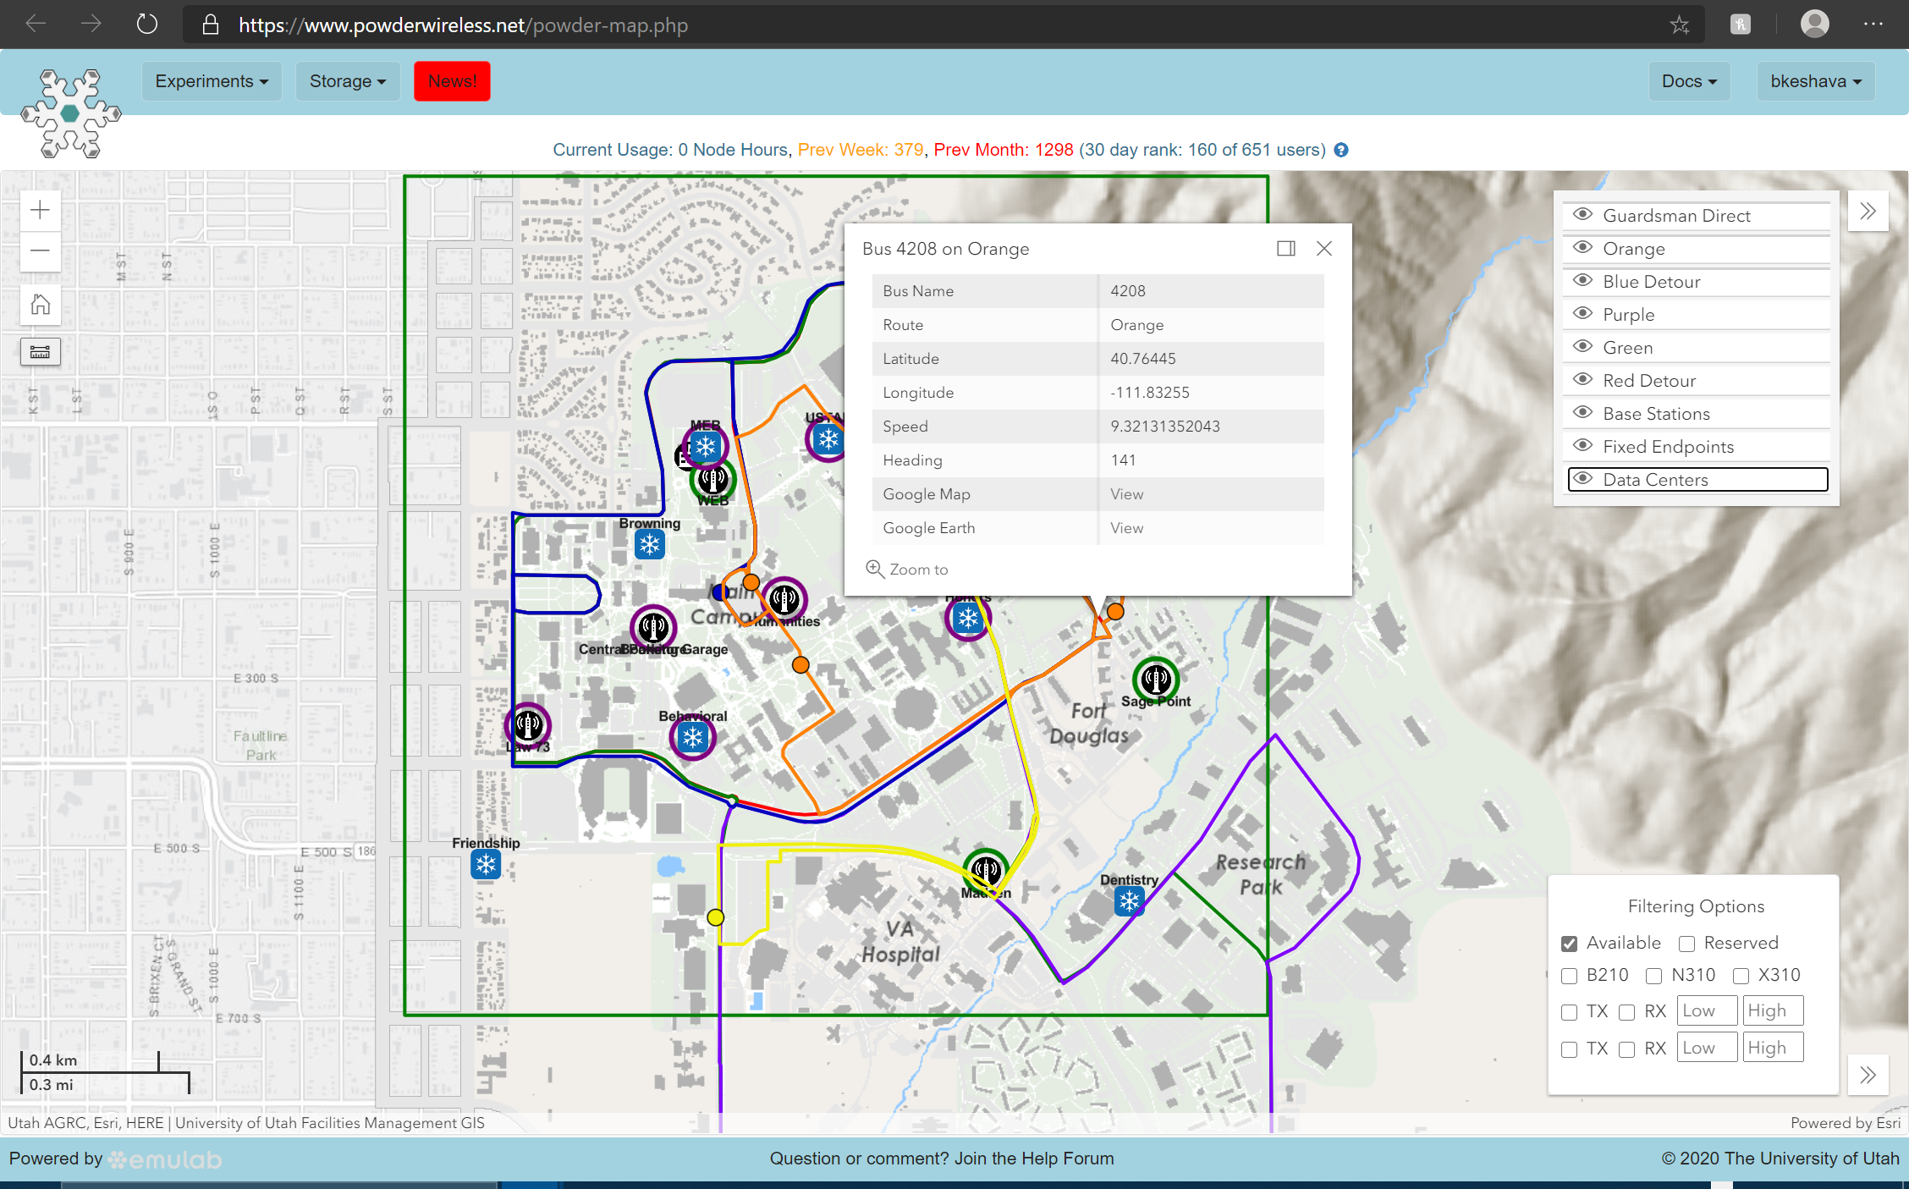
Available Mobile-Endpoints on POWDER & their Relative Routes On-campus (UofU)

Slide 36
POWDER Update on available features
Updates based on POWDER Q&A on 12/10/2020
mMIMO BS and clients are being refurbished and relocated: they will be back online at the end of Dec 2020
Access to the Xilinx Zynq SoC (ARM PS + PL) on-board the Skylark/Faros BS and IRIS clients will be granted to design our own functional blocks:
Beacon beam-sweeping, AGC, Client timing synchronization, TDD framer, etc.
If our design cannot be implemented in the software layer (APP), this access to re-flash the FPGAs with our functional blocks will be helpful.
GPUs will be made available on a maximum of 3 rooftop BSs (USRP X310 + d740/d840 compute) to test the BAM! Wireless radio as is
BAM! Wireless radio with CUDA-specific components replaced with GNURadio components is working on POWDER: simple file-transfer flows have been tested
BYOD: Access to the mobile end-points (shuttles) at UoU to install our rotator is limited. Alternate solutions recommended—however, we will still have access to the rooftop nodes, compute, and backhaul.

Slide 37
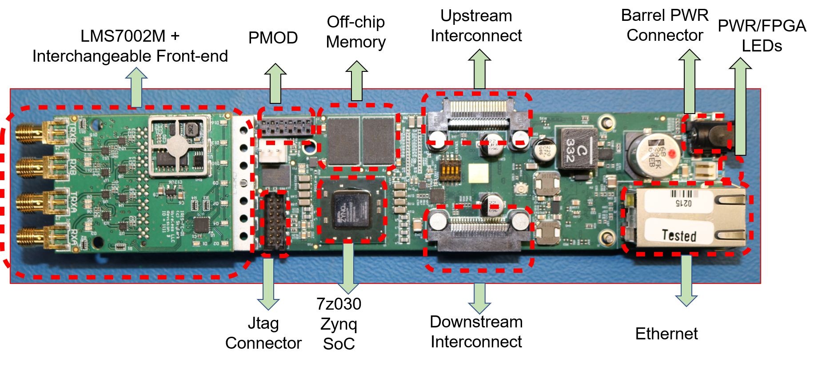
mMIMO Resources: IRIS SDR (Source: RENEW)

Slide 38
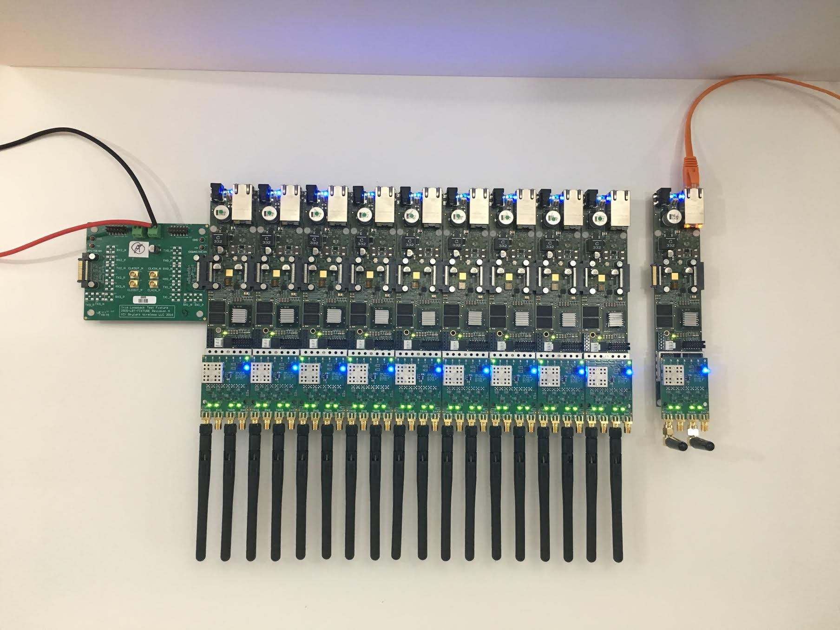
mMIMO Resources: Daisy-chained IRIS SDRs at the BS (Source: RENEW)

Slide 39
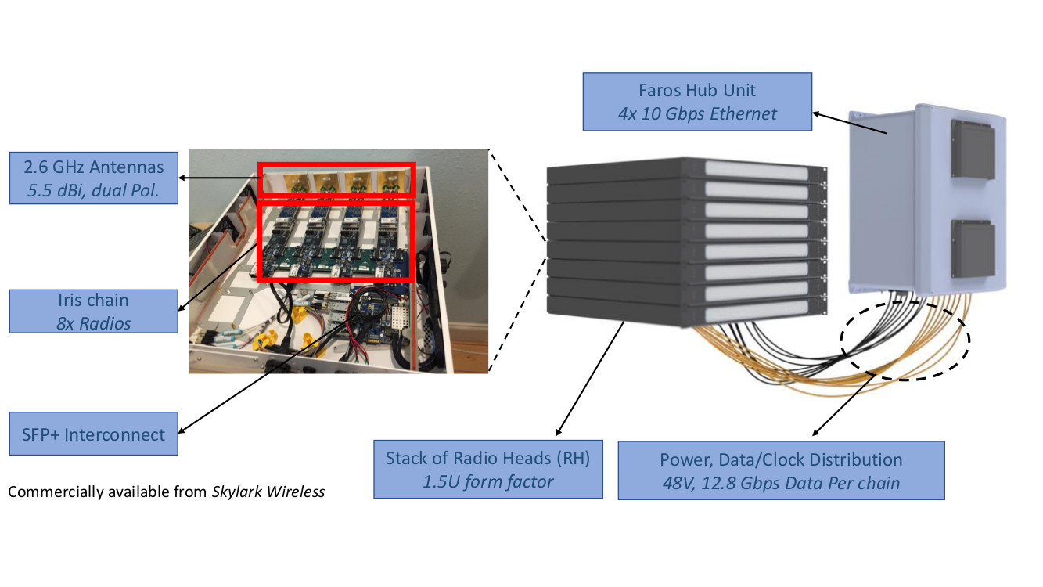
mMIMO Resources: Skylark/Faros BS (Source: RENEW)

Slide 40
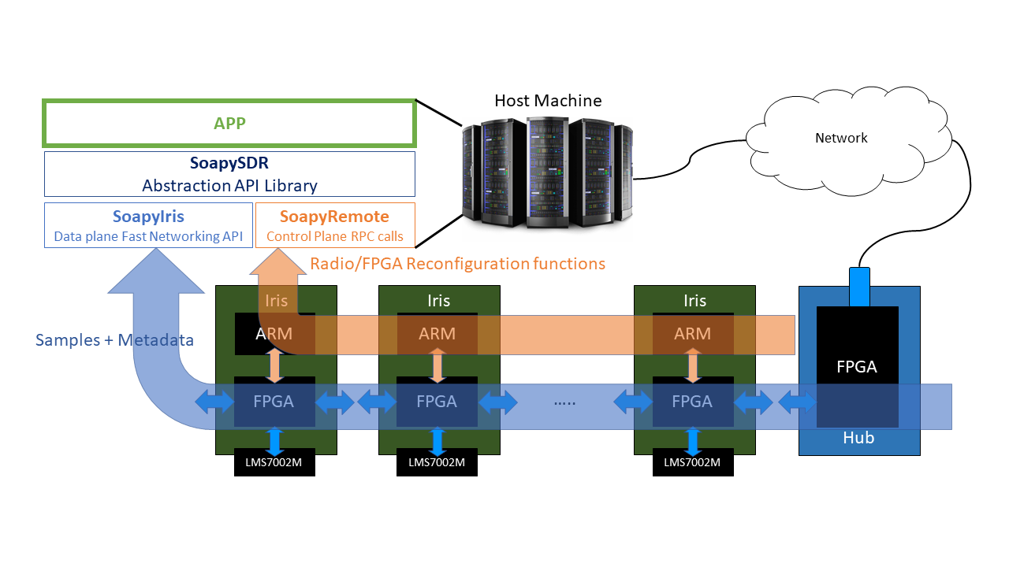
mMIMO Dev: Abstraction (Source: RENEW)

Slide 41
Massive MIMO Experiments
A simple sounder framework
Record pilot signals from the 2 IRIS clients received at all the antennas of the Skylark/Faros mMIMO BS ((4 RHs x 4 SDRs) + (8 RHs x 2 SDRs)) x 2 Tx/Rx chains = 64 antennas)
Post-process these recorded signals (HDF5 matrices) for channel statistics
Additionally, beacon beam-sweeping can be tested at startup: open-loop cell discovery at the clients

Slide 42
POWDER: Q&A

Slide 43
Purdue Measurement Campaign: Rotation Angle Estimation
Design Details: Accuracy of rotation angle estimation from the provided SparkFun (Blackboard C + BNO0080) platform
STM32F407 (uC) and MPU-9250 (IMU) on-board the e-puck2 robot will provide accurate rotation angle measurements (as the robot is rotated using stepper-motors)
A combination of heading information (from the magnetometer on-board) and gyro rotation axis data (from the gyroscope on-board) help us accurately use the rotation angle determined from this e-puck2 robot as the “reference”
Readings validated over multiple trials
ATMega328P (Arduino UNO uC) and BNO0080 IMU platform (current design platform for rotation-angle determination in the measurement campaign)
I2C scanner
Rotation angle estimations: from the gyroscope on-board BNO0008—with motor control via STM32F407

Slide 44
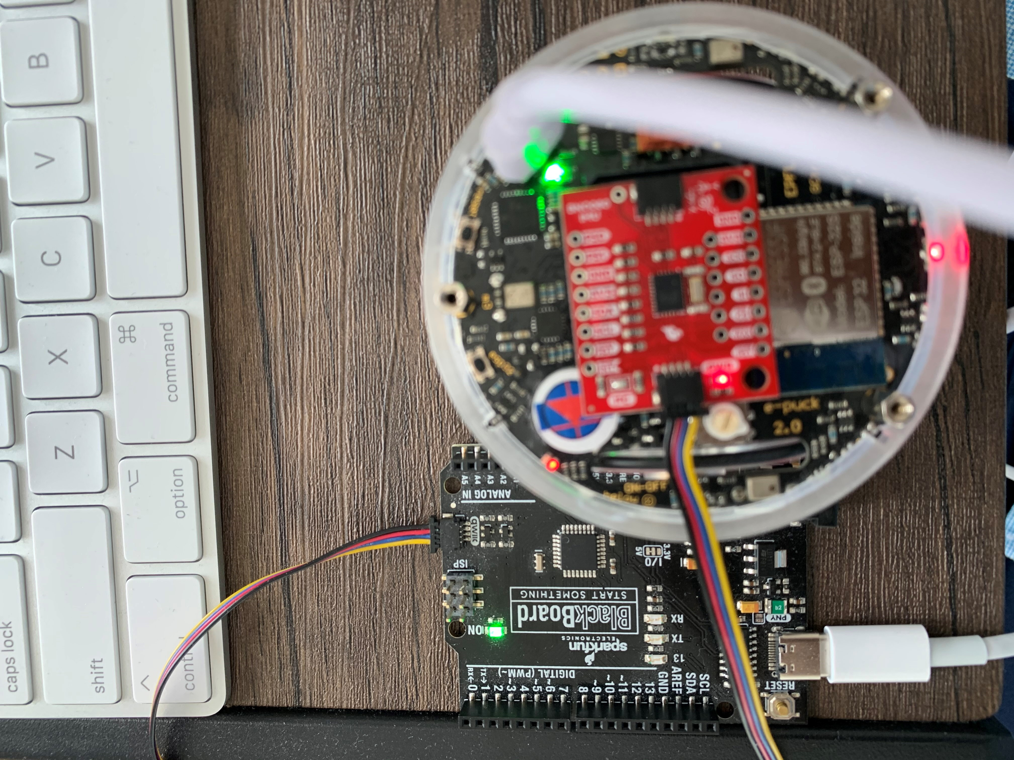
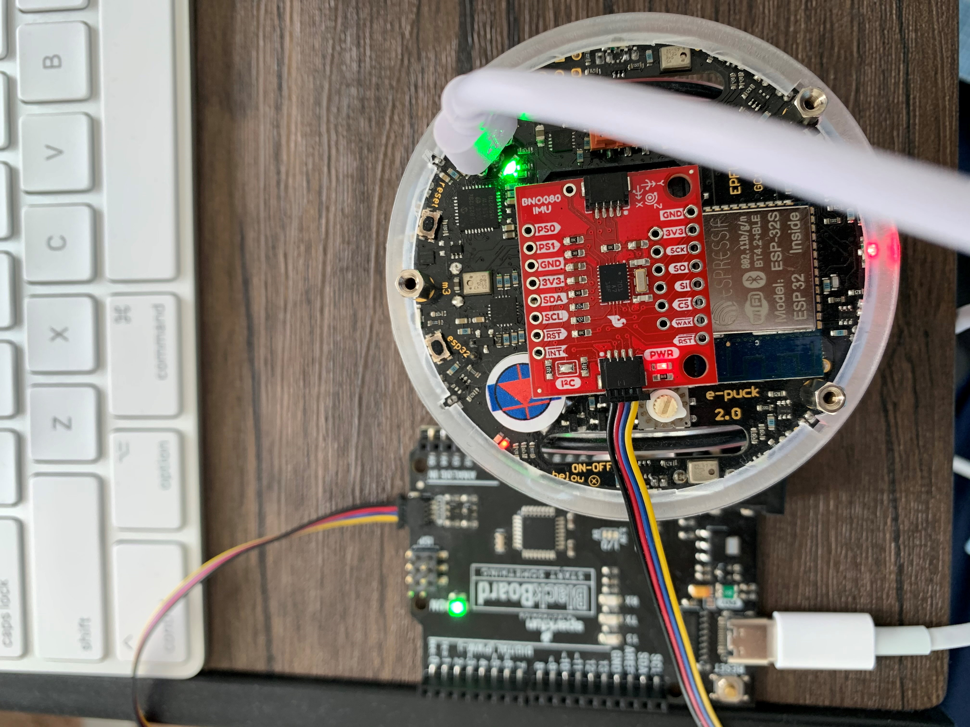
Design Setup
LED indicating heading (using magnetometer)
IMU BNO0008
ESP32 WiFi radio for data-logging over campus WiFi
Arduino UNO: SparkFun BlackBoard C

Slide 45
Platform 1: STM32F407 (uC) and MPU-9250 (IMU)
Rotation angle estimation with the Gyroscope
(Additional confirmation by magnetometer & stepper motor control data)

Slide 46
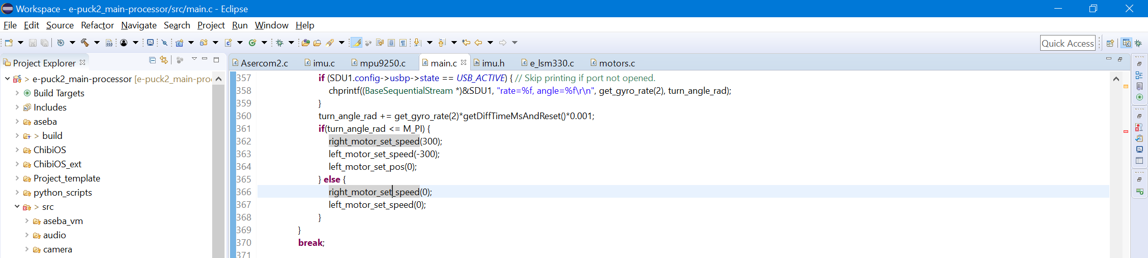
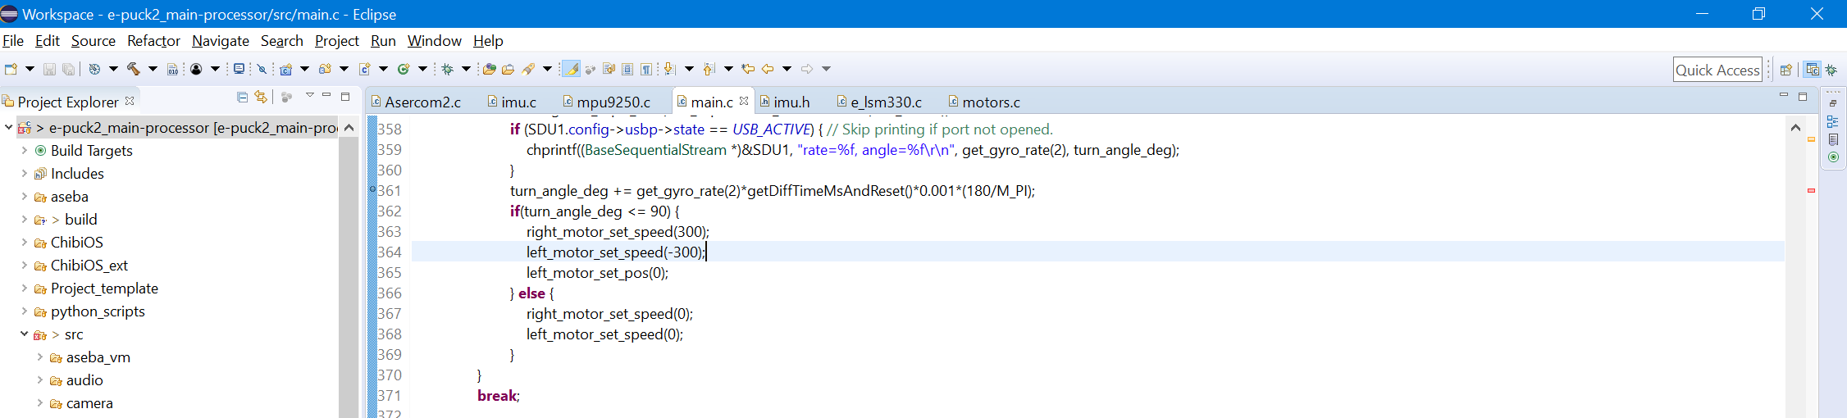
e-puck2 Reference Angle Determination using the on-board Gyroscope
(validated in multiple trials via Stepper Motor control & Magnetometer readings)

Slide 47
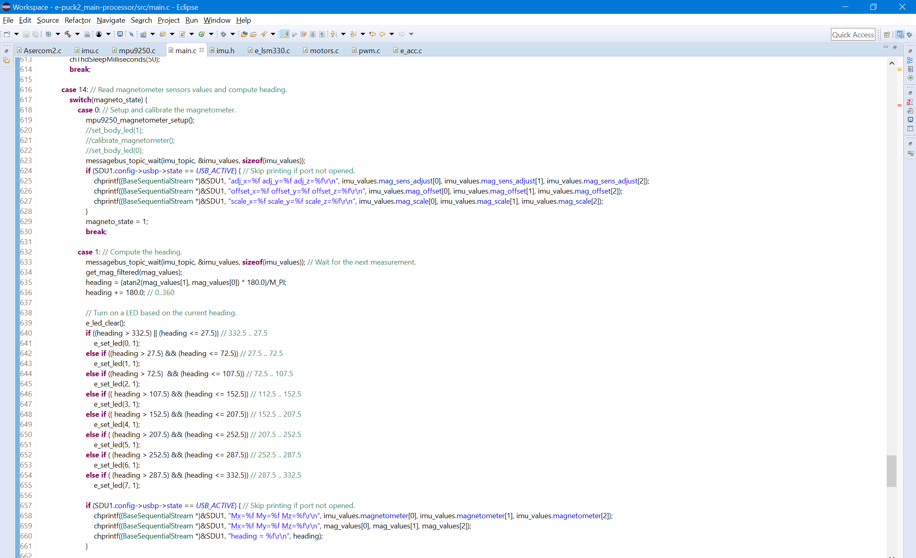
Corroborate the estimated angle by determining the heading from magnetometer values
(LED references for additional corroboration – see slide #39)

Slide 48
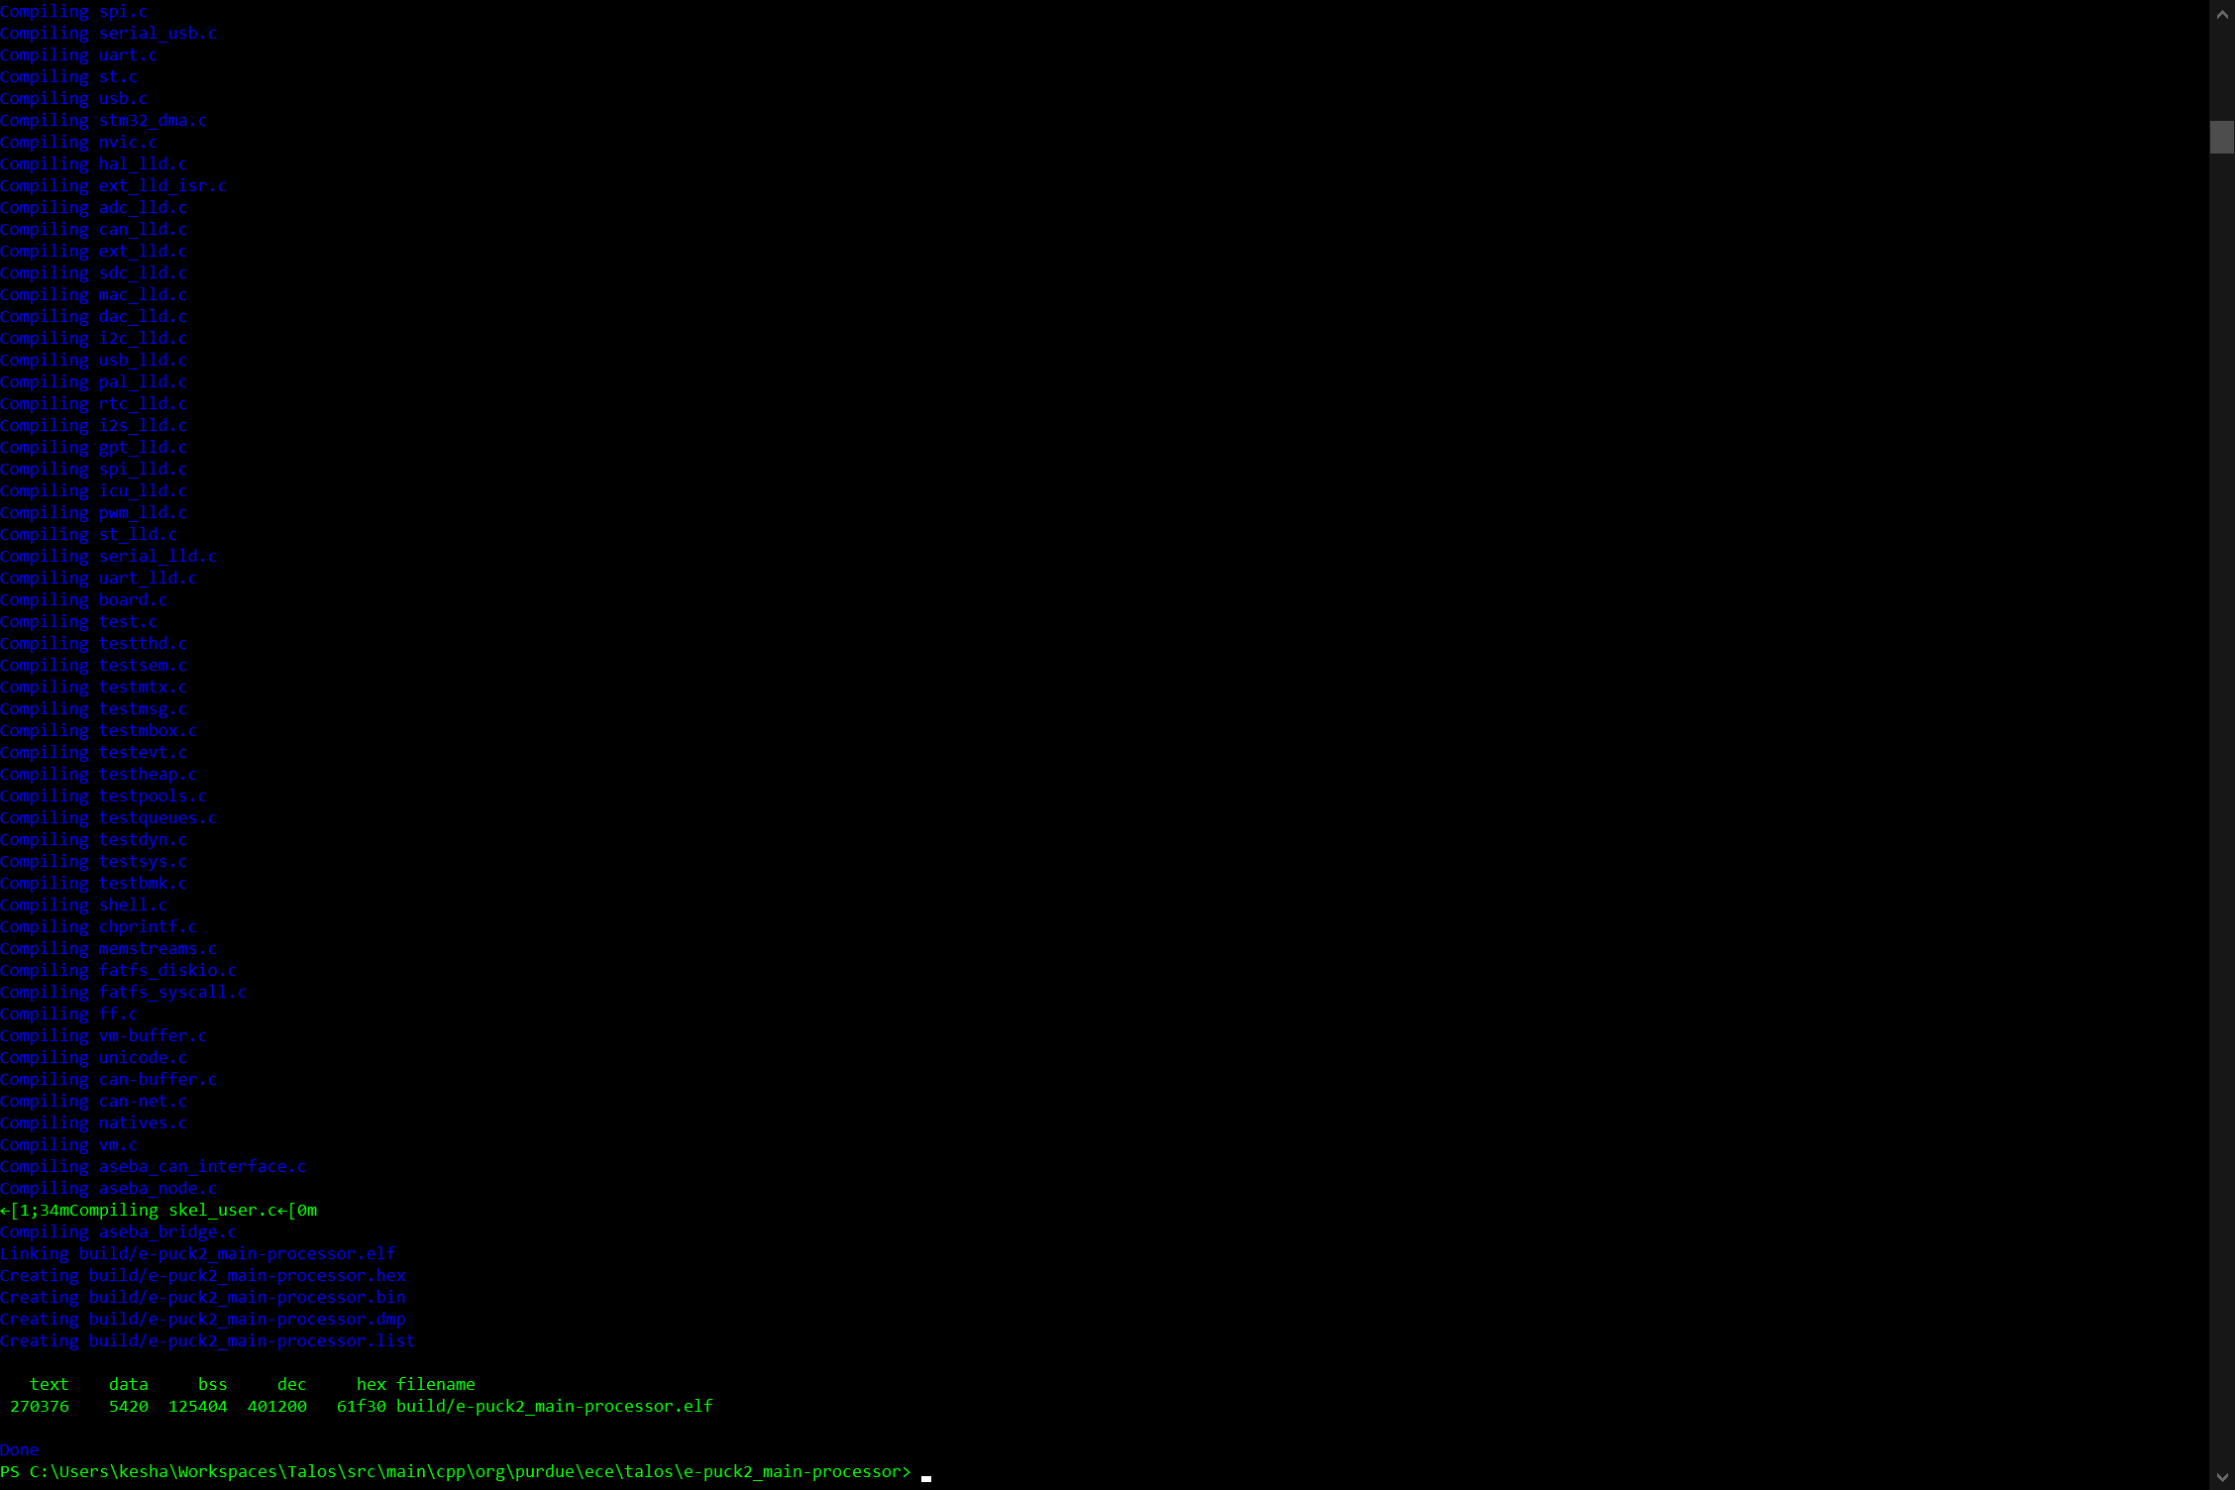
e-puck2 Reference Angle Determination: Firmware Build

Slide 49
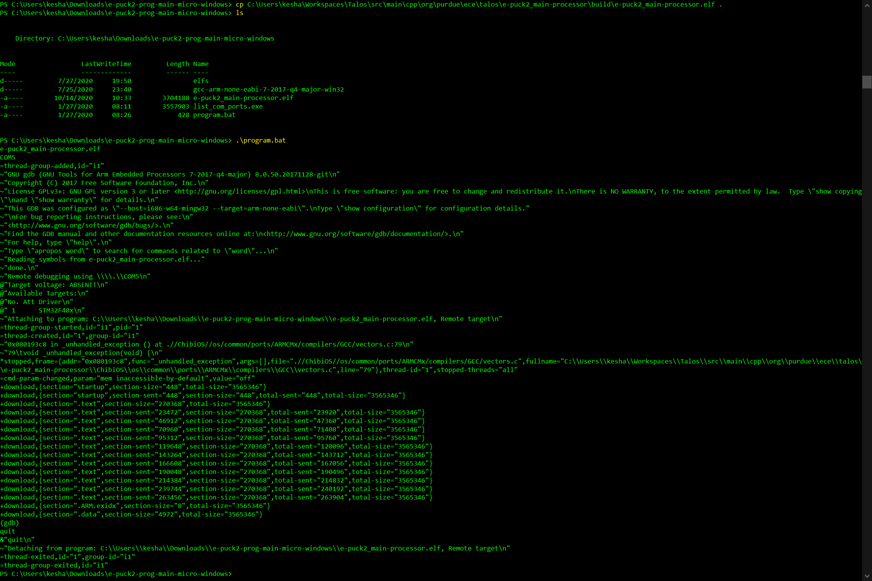
e-puck2 Reference Angle Determination: Burning the new firmware onto STM32F407 on-board e-puck2

Slide 50
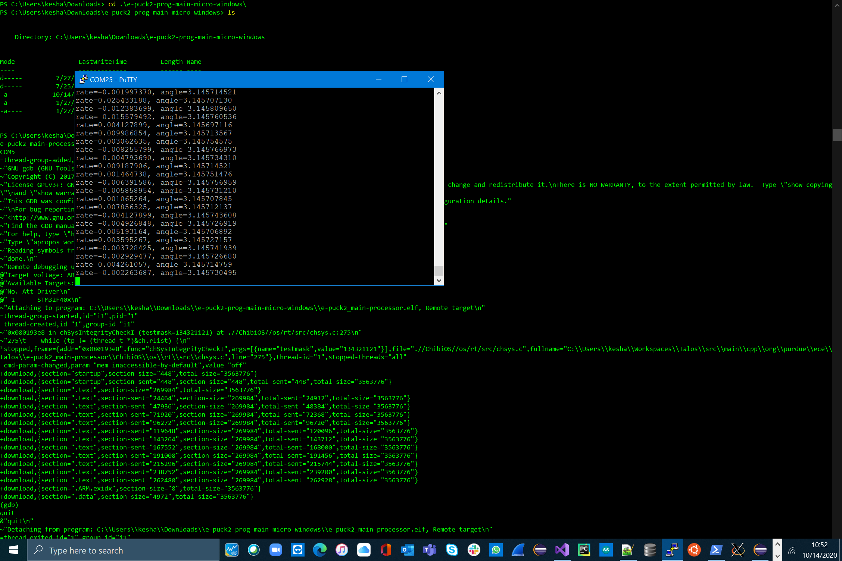
Corroborated by “Heading” which can be determined using the Magnetometer
(check slide #39 and #42)
Run 1 - e-puck2 Reference Angle Determination: Serial Monitor Logs with the rotation-angle in radians

Slide 51
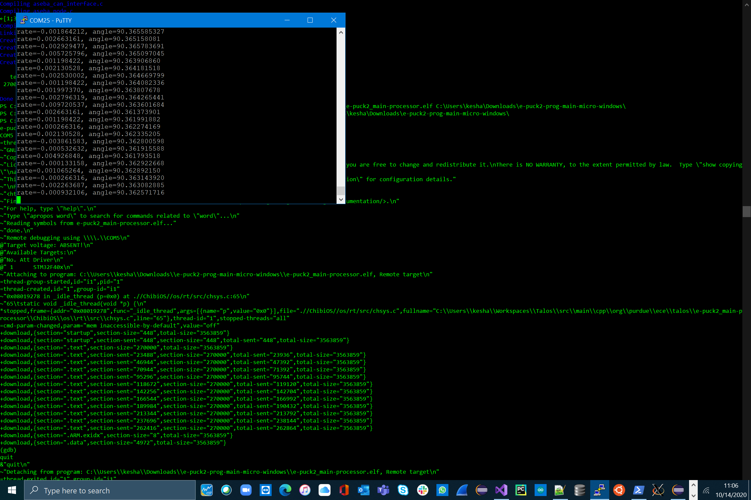
Corroborated by “Heading” can be determined using the Magnetometer (check slide #39 and #42)
Run 2 - e-puck2 Reference Angle Determination: Serial Monitor Logs with the rotation-angle in degrees

Slide 52
Platform 2: SparkFun Blackboard C (uC) with BNO0008 (IMU)
(Approach 1: Quaternion (complex rotation vectors))
(Approach 2: Gyroscope – Integrate angular velocity rate over time)

Slide 53
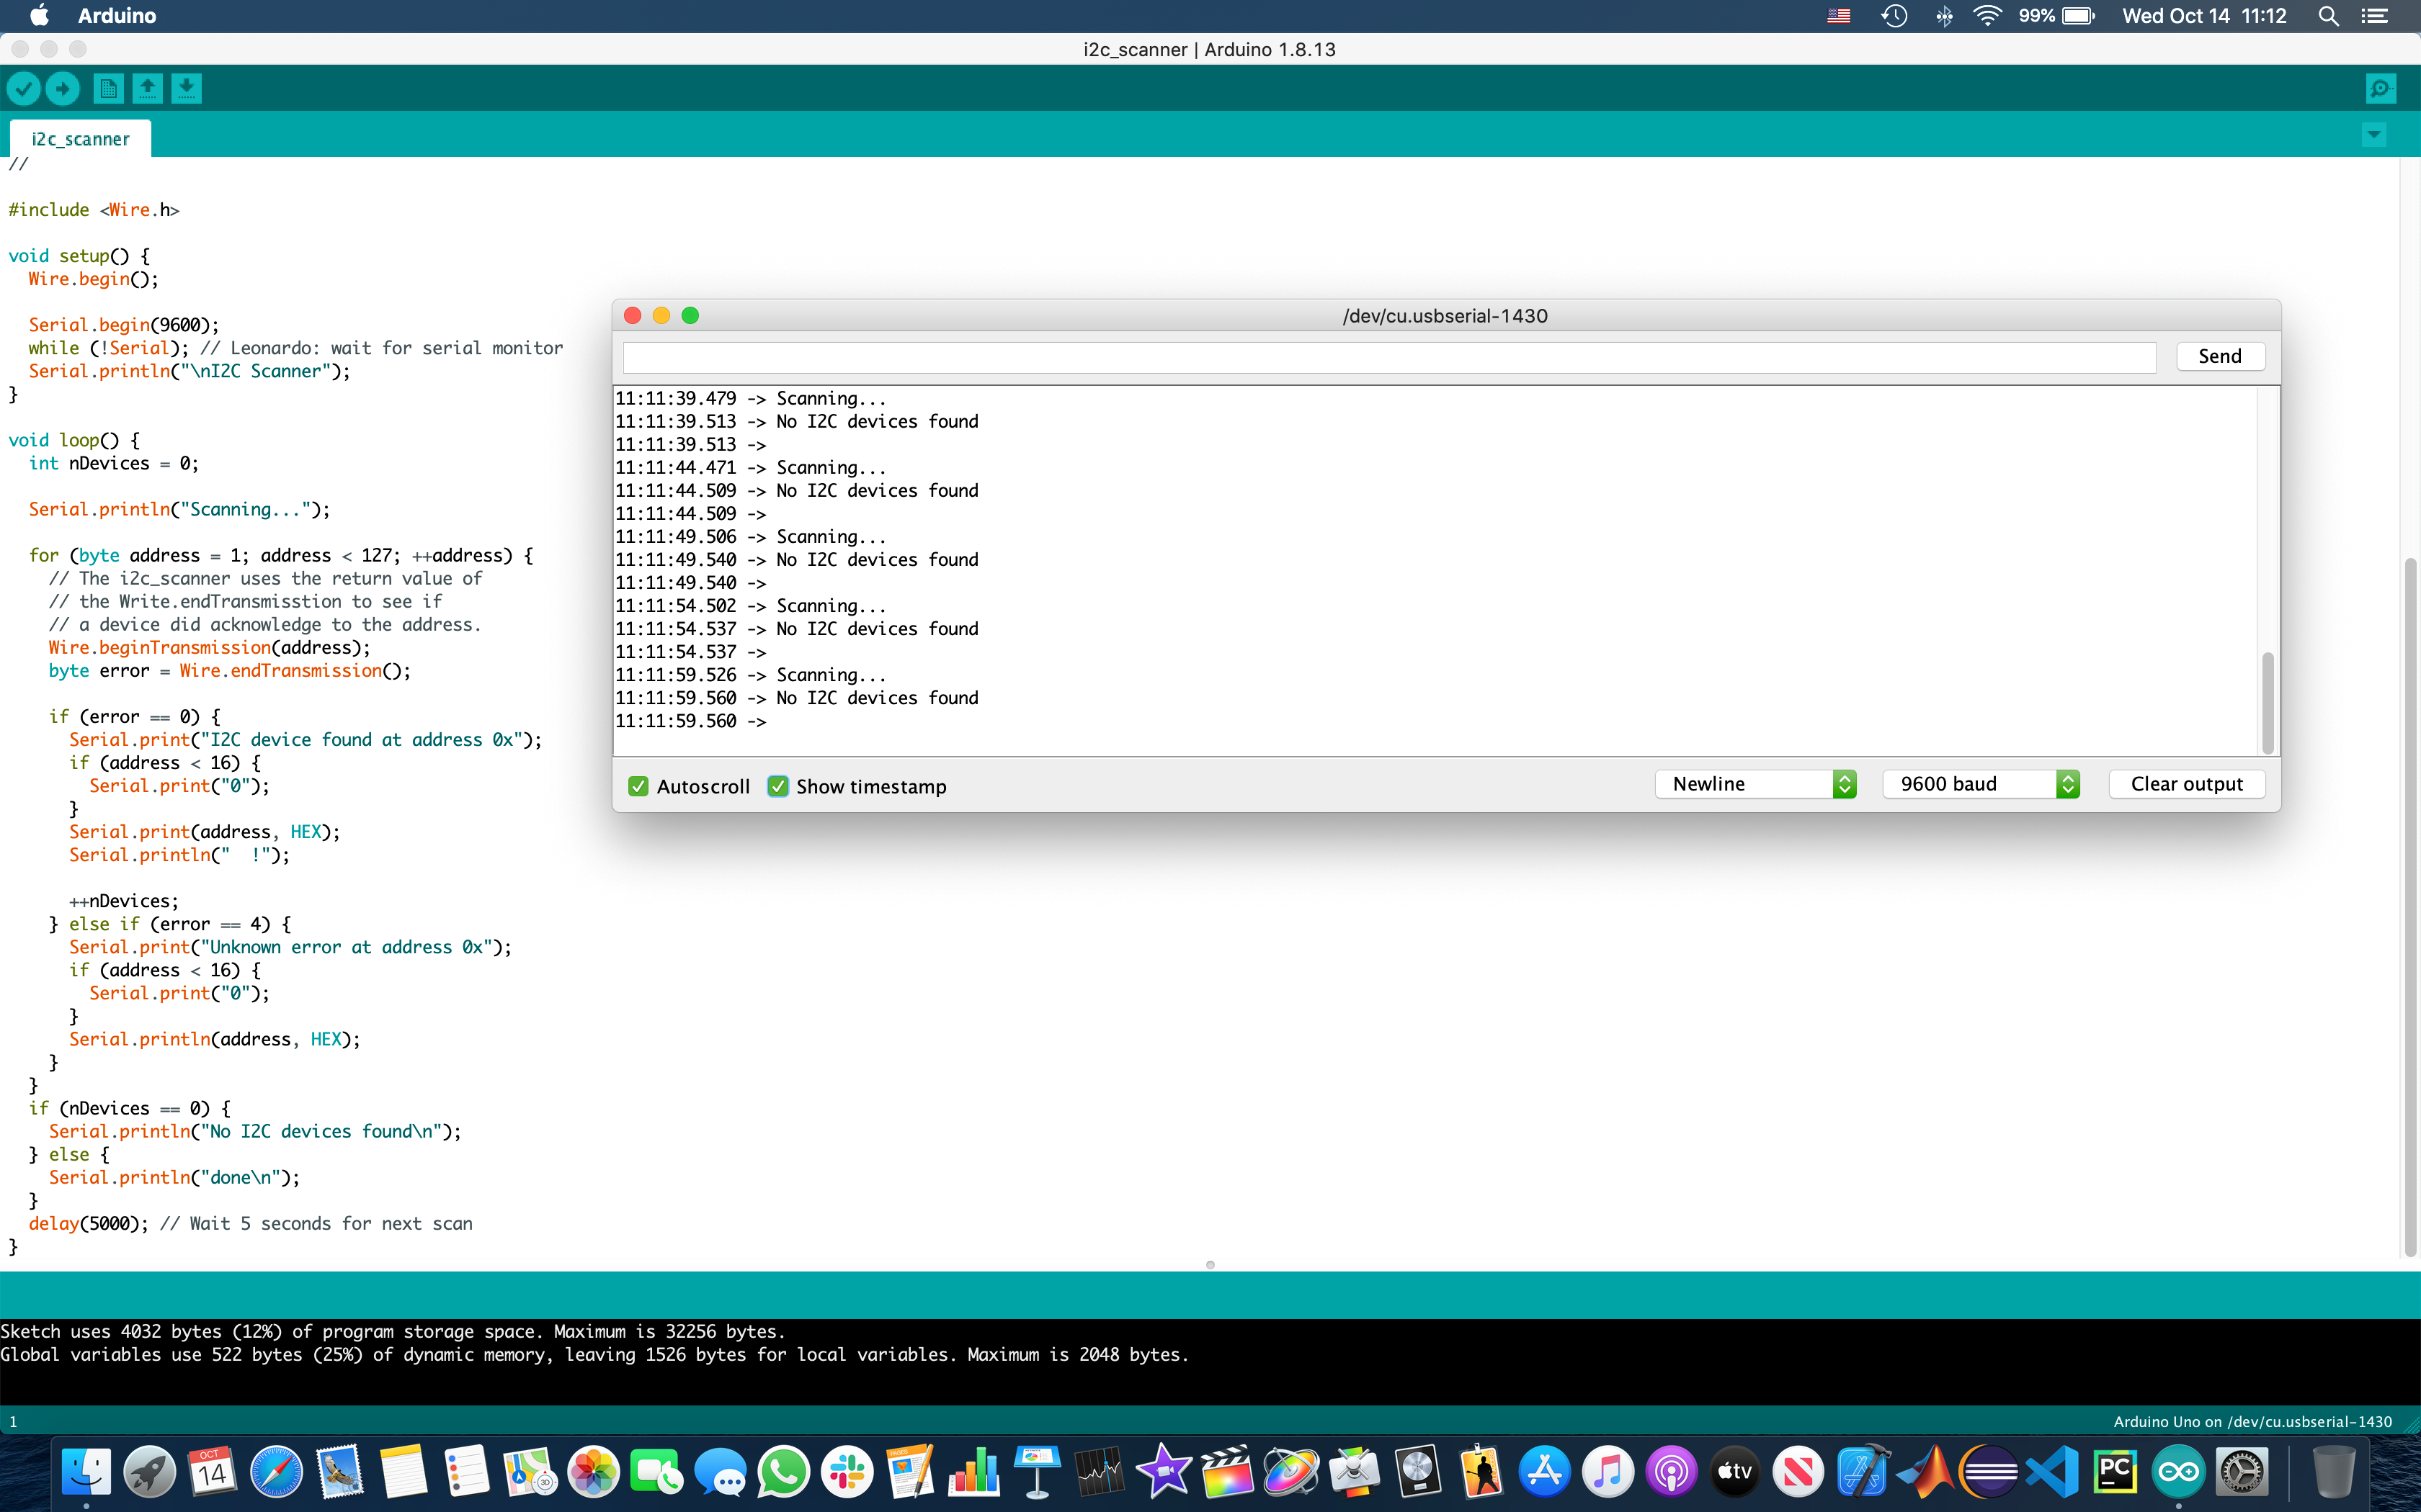
*Platform: Mac (USB-C for Blackboard C)
I2C Scanner: No IMU Connected

Slide 54
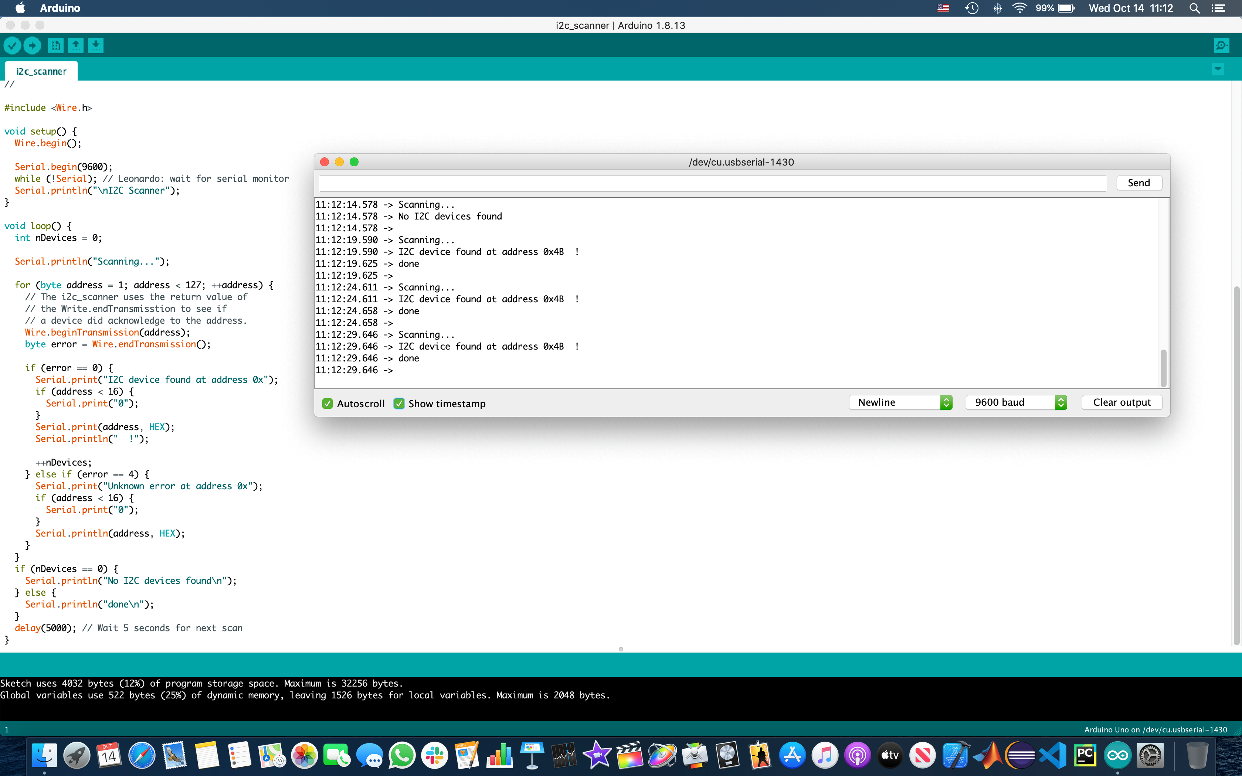
I2C Scanner: IMU (BNO0080) Connected

Slide 55
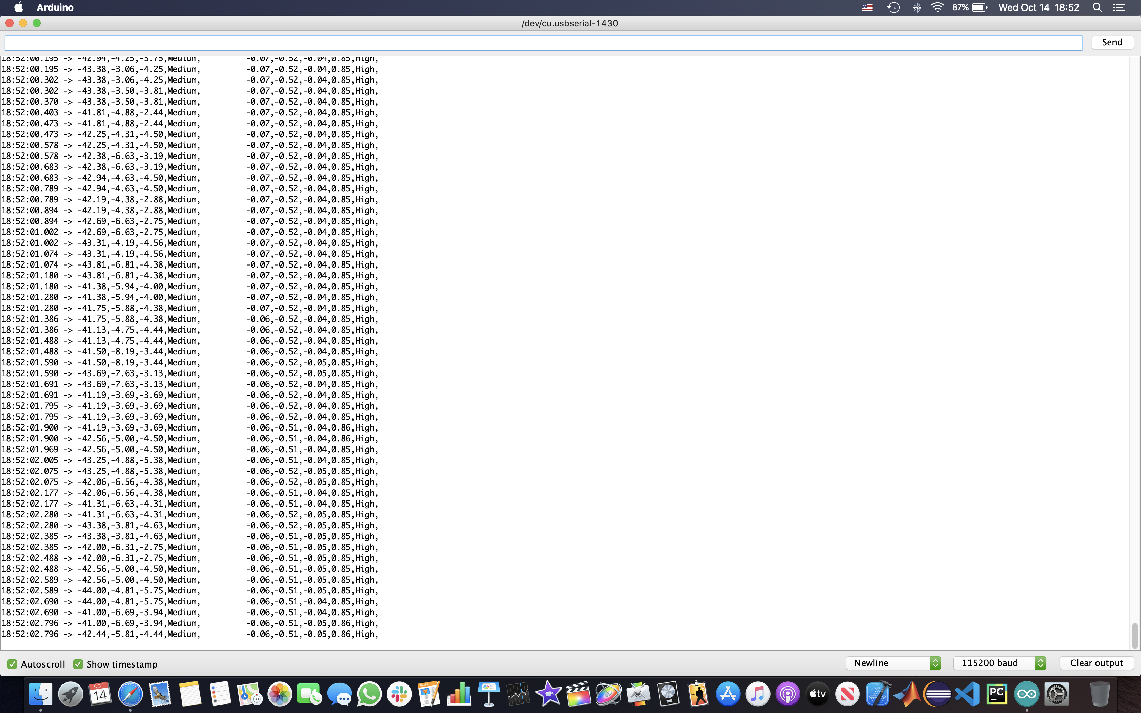
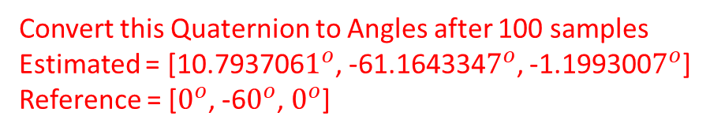
Convert this Quaternion to Angles after 100 samples
Estimated = [10.793706$1^{o}$, -61.164334$7^{o}$, -1.199300$7^{o}$]
Reference = [$0^{o}$, -6$0^{o}$, $0^{o}$]
Approach 1 - The Quaternion Approach: Post-Calibration

Slide 56
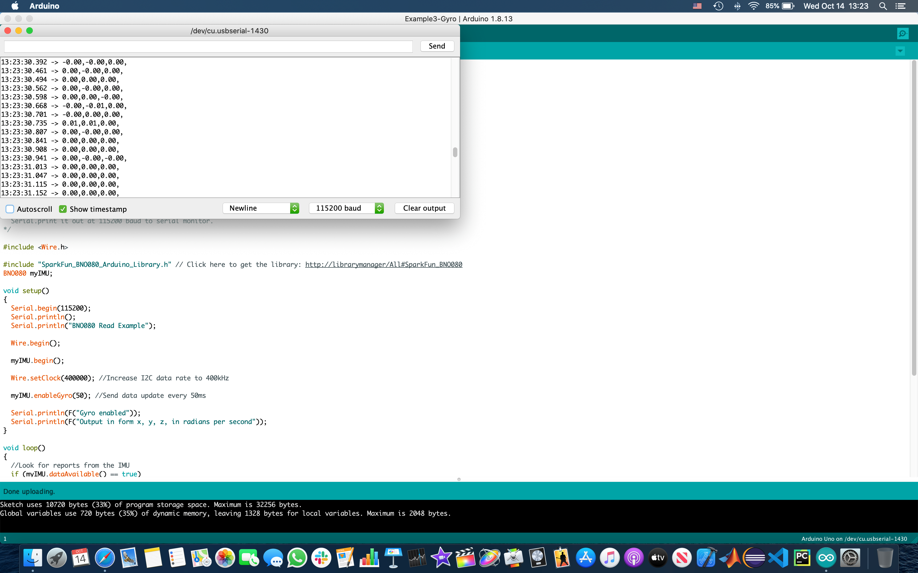
Initial calibration is good (no rotation)
Approach 2 - Gyroscope Initial Calibration: No rotation

Slide 57
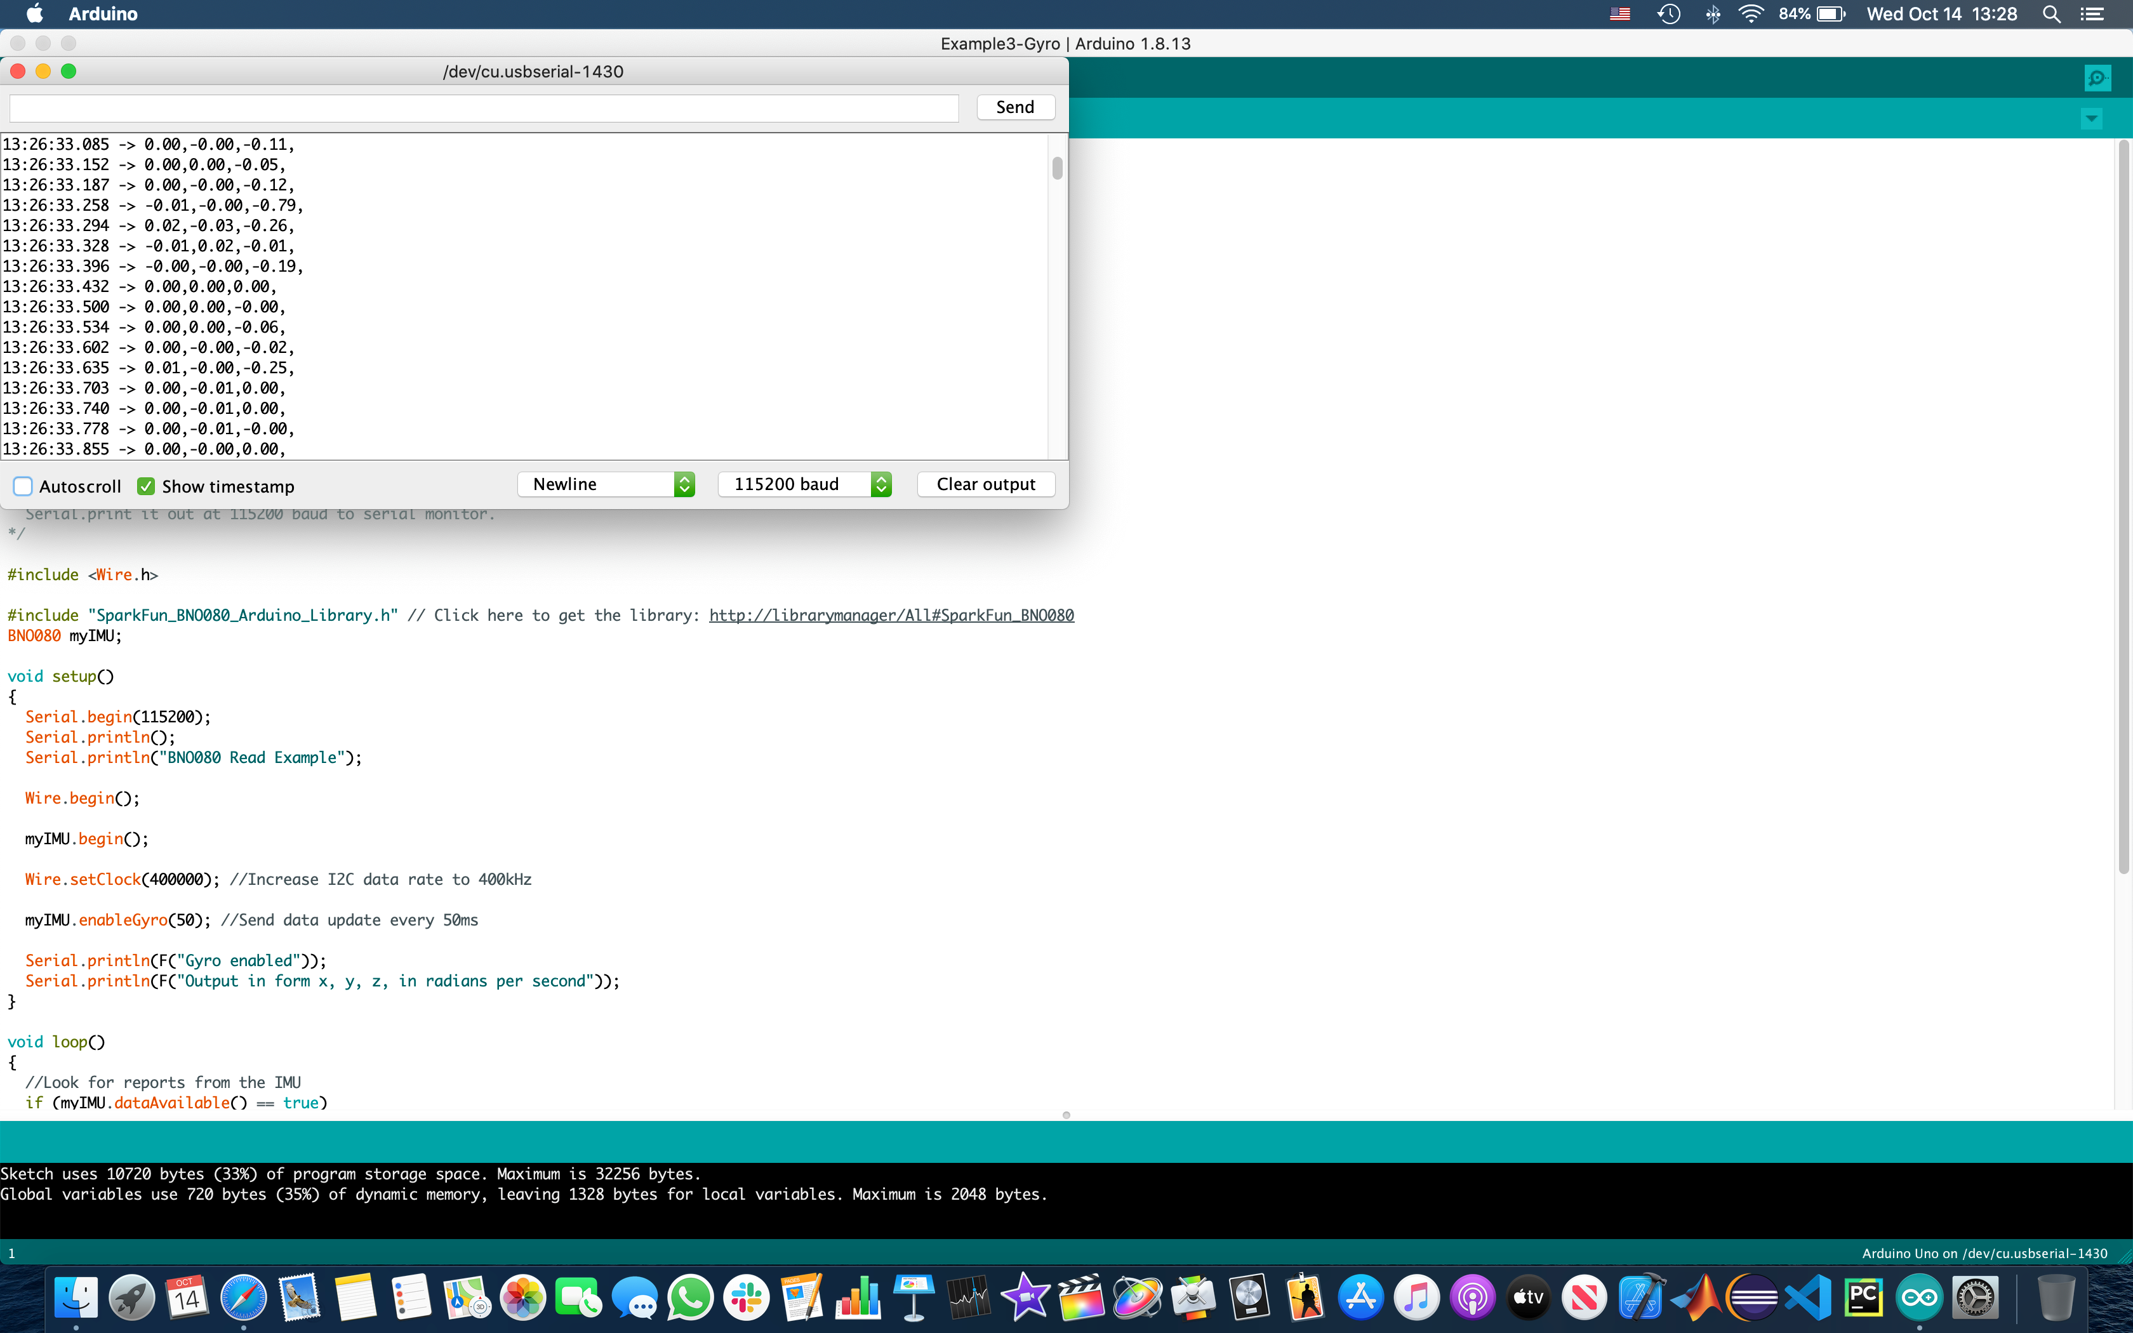
Z-axis rates integrated over time
Estimated Angle = 90.52733 degrees
Reference Angle = 90 degrees
Good, but unstable over multiple trials
The plan is to continue with this approach and try to bring about stability in measurements; then proceed with similar solutions for the pitch movements
Approach 2 (contd) - Rotation Angle Determination: Gyro values in real-time

Slide 58
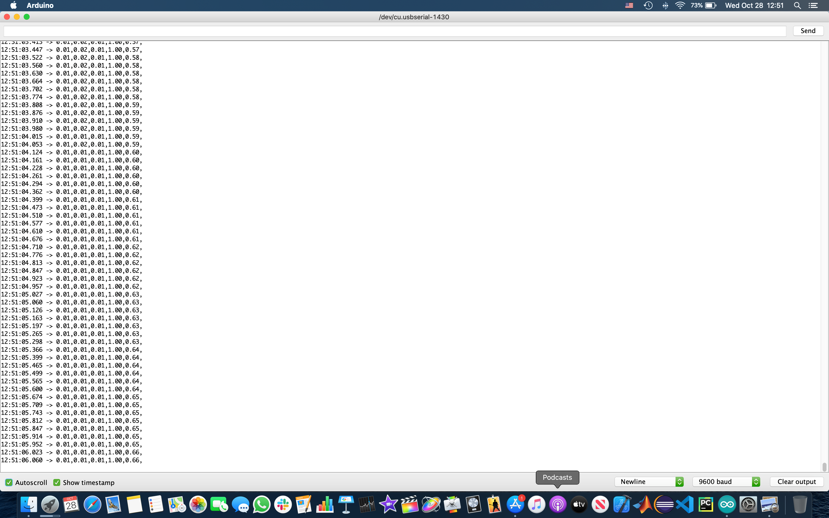
Post-Calibration and Flash-Save: No Rotation; Collect data after 100 samples;
Quaternion Complex Vector: [0.01, 0.01, 0.01, 1.00];
Estimated Rotation Angles (in degrees): [0.0197994, 0.0201953, 0.0197994]

Slide 59

Post-Calibration and Flash-Save: -180 degree Yaw Rotation; Collect data after 100 samples;
Quaternion Complex Vector: [0.04, 0.01, 1.00, 0.01];
Estimated Rotation Angles (in degrees): [-1.145992, 1.1457628, -179.9885408]

Slide 60

Post-Calibration and Flash-Save: 20 degree Pitch Rotation; Collect data after 100 samples;
Quaternion Complex Vector: [0.01, 0.18, 0.01, 0.98];
Estimated Rotation Angles (in degrees): [0.9877604, 20.8233814, 0.9877604]

Slide 61

Post-Calibration and Flash-Save: -20 degree Pitch Rotation; 180 degree Yaw Rotation;
Collect data after 100 samples;
Quaternion Complex Vector: [-0.17, 0.02, 0.99, 0.03];
Estimated Rotation Angles (in degrees): [-1.1926113, -19.4852726, 179.7952225]

Slide 62
Rotator Prototype: Laser Testbed Build-I
(Alpha Build: v20.11)

Slide 63

Rotator Prototype: Laser Test-bed Dev – Design View I
HS-785B Tilt (Pitch and Roll: XY-plane) Servo
7:1 Gear Ratio
Arduino Uno uC on SparkFun Blackboard Rev C
ServoCity PT785-S Pan & Tilt Kit
SparkFun BNO080 IMU (I2C)
HS-785B Pan (Yaw: Z-axis) Servo
7:1 Gear Ratio

Slide 64

Rotator Prototype: Laser Test-bed Dev – Design View II
The cardboard canvas with the home plate reference thumb-tack (0-degrees)
USB-C from PC for board power-supply
(Replaced with an Anker Ultra-Compact Portable Charger)

Slide 65

Rotator Prototype: Laser Test-bed Dev – Design View III
A webcam monitoring the cardboard canvas for “Blob Detection” and “Tracking (with x-y coordinates)” for the laser beam
A press-button laser pointer
(Replaced with a constant-ON laser pointer)
Components held together by tape
(Replaced with zip-ties)
A Cardboard Base with thumb-tacks and tape
(Replaced with a metal base plate)

Slide 66

Demo Video-1: Coarse Yaw Rotation Testing
6 rotation angles along the Z-axis (Yaw): $X≡\{{15}^{o}, {30}^{o}, {45}^{o}, {60}^{o}, {75}^{o},{90}^{o}\}$
Anti-clockwise rotation to $x∈X$ and back home to $0^{o}$ (home-plate)
Steady-State: 100 IMU readings (to avoid NaN values)
1 trial per rotation angle (x2: to-and-fro)
No object tracking
Establish the platform’s accuracy with a coarse testing strategy
Required-Angle and Rotated-Angle values printed on the Serial Monitor after each to-and-fro rotation
Average errors: $Y≡ \{{15}^{o}:{2.925}^{o}, {30}^{o}:{1.27}^{o}, {45}^{o}:{0.88}^{o}, {60}^{o}:{0.605}^{o}, {75}^{o}:{0.495}^{o}, {90}^{o}:{0.66}^{o}\}$

Slide 67
Play Coarse_Yaw_Testing_6_Angles_1_Trial_Per_Angle.mov

Slide 68

Demo Video-2: Fine Yaw Rotation Testing
6 rotation angles along the Z-axis (Yaw): $X≡\{3^{o}, 6^{o}, 9^{o}, {12}^{o}, {15}^{o},{18}^{o}\}$
Anti-clockwise rotation to $x∈X$ and back home to $0^{o}$ (home-plate)
Steady-State: 100 IMU readings (to avoid NaN values)
1 trial per rotation angle (x2: to-and-fro)
No object tracking
Establish the platform’s accuracy with a fine testing strategy
Required-Angle and Rotated-Angle values printed on the Serial Monitor after each to-and-fro rotation
Average errors: $Y≡ \{3^{o}:{0.98}^{o}, 6^{o}:{1.035}^{o}, 9:{2.885}^{o}, {12}^{o}:{2.145}^{o}, {15}^{o}:{2.075}^{o}, {18}^{o}:{0.755}^{o}\}$

Slide 69
Play Fine_Yaw_Testing_3_Degree_Increments_1_Trial_Per_Angle.mov

Slide 70

Demo Video-3: Multi-Trial Coarse Yaw Rotation Testing
3 rotation angles along the Z-axis (Yaw): $X≡\{{30}^{o}, {60}^{o}, {90}^{o}\}$
Anti-clockwise rotation to $x∈X$ and back home to $0^{o}$ (home-plate)
Steady-State: 100 IMU readings (to avoid NaN values)
3 trial per rotation angle (x2: to-and-fro)
No object tracking
Establish the platform’s accuracy with a multi-trial coarse testing strategy
Required-Angle and Rotated-Angle values printed on the Serial Monitor after each to-and-fro rotation
Average errors: $Y≡ \{{30}^{o}:{2.41}^{o}, {60}^{o}:{1.843}^{o}, {90}^{o}:{2.46}^{o}\}$

Slide 71
Play Coarse_Yaw_Testing_3_Angles_3_Trials_Per_Angle.mov

Slide 72


Observations: $α$-build v20.11 (No Tracking)
Pure IMU yaw angle estimation: Errors are high ($1^{o}−3^{o}$)
Causes for concern:
PC-uC USB cable recoil,
Unstable cardboard base, and
Improper packaging of the IMU on-board the rotator platform
Solutions (discussed next):
Ultra-compact portable charger zip-tied to the rotator platform to avoid PC-uC USB cable recoil,
PT785-S pan & tilt kit bolted to a sturdy metal base plate,
uC, IMU, and wiring properly packaged on-board the rotator platform via zip-ties
Achieve higher precision by adding another gear set (7:1 (stock) + 3.8:1 (available))

Slide 73

Demo Video-4: Object Tracking Walk-through
SwisTrack server-client exchanging NMEA messages corresponding to the “tracked particles”: TCP/IP 127.0.0.1:3000
Configurations: Input frames from the USB camera, Background subtraction, RGB Thresholding, Blob Detection, and Particle Tracking
Parse the NMEA messages: (x, y) coordinates of the home plate ($0^{o}$ thumbtack) and the other reference thumbtacks on the cardboard canvas
Post-processing Analysis: Use the (x, y) messages received by the SwisTrack client to plot the “cloud of spots around the reference thumbtack”
Error Analysis Verification: Error determined from the actual and estimated angles evaluated on the uC-IMU pair and printed on the Serial Monitor

Slide 74
Play Object_Tracking_Walk-through.mov

Slide 75

Demo Video-5: Complete Setup ($α$ - v20.11)
Constant-ON laser pointer: Z-bolt BTE-4S Red from OpticsPlanet
Cardboard base with the PT785-S pan & tilt kit held in place by tape and thumbtacks
White cardboard canvas with reference thumbtacks
SparkFun Blackboard Rev C (Arduino Uno uC) with BNO080 IMU
uC powered by PC via USB-C
SwisTrack server-client NMEA framework via a Logitech USB camera for frame capture/object tracking

Slide 76
Play Sample_Test_Rotation_Constant_ON_LASER_with_Frame_Tracking.mov

Slide 77

ServoCity PT785-S Pan & Tilt Kit
2 HS-785HB servos: 1000 $μ$s – 2000 $μ$s PWM signal range
7:1 gear ratio (stock option): 12 teeth on the servo gear | 84 teeth on the mount gear
3.8:1 gear ratio: 20 teeth on the servo gear | 76 teeth on the mount gear
${218}^{o}$ kit (7:1) range for ${1525}^{o}$ servo range (corresponding to the full PWM signal range)
JM-1100B jib mounting kit (base is not wide-enough)
Route the wires and cables through the 1’’ hollow aluminum shafts
Capability to add another gear set to achieve a higher overall gear ratio: Higher precision, Lower speed, Higher Torque
Motor Torque = 183 oz-in (1281 oz-in with the 7:1 gear set)
Motor speed (6V) = 259 degrees/sec (37 degrees/sec with the 7:1 gear set)
Maximum payload = 6 lbs.
Platform weight = 1.8 lbs.
1 pt every ${2.8}^{o}$ precision for the 3.8:1 gear set
1 pt every ${1.5}^{o}$ precision for the 7:1 gear set

Slide 78

PT785-S Schematic
Source: ServoCity

Slide 79
Rotator Base Mount Design
Screencast: https://autode.sk/37jlZfm
Aluminum 6061 stock material machined to the required specifications in terms of its length (12"), width (12"), and thickness (0.5"). Holes to be drilled through this plate for the fasteners (1/4-20 hex bolts, 3/8-16 carriage bolt, #6-32 screws). Specifically, the holes to be drilled are:
Four 1/4-20 UNC threaded simple holes at the four vertices of the square plate;
Four 1/4-20 UNC threaded simple holes in a 3" circular hub pattern around the center of the square plate;
Four #6-32 UNC threaded simple holes in a 3" circular hub pattern around the center of the square plate;
Four #6-32 UNC threaded simple holes in a 1.5" circular hub pattern around the center of the square plate; and
One 3/8-16 UNC threaded simple hole at the center of the square plate.
CAD/CAM models are available--in case a CNC mill or a Waterjet is chosen as the machining equipment.
Manual drilling of the holes is also fine: sketches are available for the bolt patterns.

Slide 80


Rotator Base: Al 6061 Plate & Magnet Mounts

Slide 81


Rotator Base: Al 6061 Plate & Magnet Mounts

Slide 82

Rotator Integrated Design: v21.01

Slide 83
Component Backups
SparkFun Blackboard Rev C (x2) and SparkFun BNO080 IMU (x2)
SparkFun UBlox ZED-F9P with SMA breakout GPS board (x1)
GPS/GNSS magnetic mount antenna with a 3m SMA cable (x1)
ServoCity PT2645-S pan & tilt kit (x1)
Anker PowerCore Slim 1000 PD ultra-compact portable charger (x1)
SparkFun Bluetooth Mate Silver (x1)

Slide 84

Odin E2E Design Architecture

Slide 85
Pending Tasks
Histogram error plots for different yaw & pitch rotation angles with:
The integrated design (including the base mount) in stationary settings, and
Servo speed regulation for smoother transitions between ON/OFF states.
E2E testing in non-stationary settings with:
Tx PT2645-S pan & tilt kit | Blackboard uC | BNO080 IMU | UBlox ZED-F9P GPS;
Rx PT785-S pan & tilt kit | Blackboard uC | BNO080 IMU | UBlox ZED-F9P GPS | Bluetooth Mate Silver;
Apache Kafka as the publish-subscribe framework between the Tx and Rx;
Tx GPS coordinates are fixed, and hence, are hard-coded into both the Python controllers;
Rx ZED-F9P receives RTCM correction streams from an NTRIP client over Bluetooth;
Rx Python controller receives the GPS coordinates as NMEA messages from the ZED-F9P over Bluetooth Serial;
Rx Python controller determines the angle it needs to rotate to and instructs its servos over Bluetooth Serial;
Rx Python controller publishes its current GPS coordinates (latitude, longitude, altitude, attitude, metadata) as a JSON event—ODIN_GPS_EVENT—to the Kafka topic ODIN_GPS_EVENTS;
Tx Python controller receives Rx’s current GPS coordinates encapsulated in an ODIN_GPS_EVENT (JSON) from the Kafka topic ODIN_GPS_EVENTS, and determines the angle it needs to rotate to; and
Tx Python controller instructs the servos to rotate to this angle over USB Serial.
Compatibility tests with PT2645-S interchanged with PT785-S

Slide 86
Design Notes
DB replaced with Apache Zookeeper and Apache Kafka:
DB is slow: the Tx significantly lags the moving Rx due to DB push/pull delays;
DB is not easily fault-tolerant;
Message administration is hard due to non-queuing;
Kafka can be made persistent;
Load-balancing and Fault-tolerance are inherent; and
Easy middleware administration for analysis.
For the GPS module backup: Use ZED-F9P with pre-built SMA breakout (robust) instead of a ZED-F9P with U.FL-SMA connector (fragile)
Do we need state estimators at the Tx like a Kalman Filter to predict the next state (GPS coordinates) of the Rx, if Kafka does not mitigate Tx response time lags well-enough?
RTCM correction streams to the ZED-F9P from an NTRIP client (Android/iOS) for excellent accuracy (1 cm – verified using both the SparkFun UBlox library and U-Center)
Using the ZED-F9P as the GNSS base station for RTCM correction streams gives a best-case scenario accuracy of 2m—so, external NTRIP client-based corrections are needed

Slide 87
UBlox ZED-F9P Accuracy Analysis

Slide 88

RTCM Corrections: Access to the UNAVCO RTCM 3.x Correction Streams from the P775 mount-point

Slide 89

GPS SIV (~27) + RTCM 3.x (on BT UART2) = 3D/DGNSS/FIXED or FLOAT
SNIP Open-Source NTRIP Caster
Lefebure NTRIP Client
Run 1: On uC Serial Port: Accuracy of GPS Receiver = ~35 cm

Slide 90

GPS SIV (~27) + RTCM 3.x (on BT UART2) = 3D/DGNSS/FIXED or FLOAT
Run 2: On u-center: Accuracy of GPS Receiver = ~53 cm
u-center Debugging

Slide 91
E2E Rx Design Documentation: Component-specific Setup & Results

Slide 92

Lefebure NTRIP Client: Receiving RTCM 3.x Correction Streams from UNAVO P775 NTRIP Caster
NMEA-formatted Rx GPS data (I2C) posted from the uC over Bluetooth Serial

Slide 93

The received NMEA-formatted Rx GPS data over Bluetooth Serial is parsed into this GPSEvent data object
The parsed data is used in-situ for angle determination AND
Published as a JSON message (re-design) to the Kafka topic ODIN_GPS_EVENTS
Parsing the Rx GPS data prior to Kafka publish

Slide 94

Apache Zookeeper Start at localhost:2181

Slide 95

Apache Kafka Server Start at locahost:9093

Slide 96
ODIN_GPS_EVENTS Kafka Topic Creation

Slide 97

Apache Kafka Published Data: NMEA (re-designed to JSON for easier processing at the Tx (subscriber) side)

Slide 98

Apache Kafka Server: Message Received from the Producer (NMEA Rx GPS from Rx Python Controller)

Slide 99
Comments
Upon receiving the GPS data, the rotation angle is determined at both the Tx and Rx Python Controllers: Rotation tasks discussed in Slides #67-#77
Next up, the comm front-end components: Complete setup & testing pending (Waiting for micro-HDMI cables for GNURadio-UHD debugging on the Raspberry Pi 4 Model B-USRP B200mini interface)
Testing with the Rx on a cart being manually moved: In progress

Slide 100
28 GHz Comm. Front-End Testing

Slide 101

PN-Sequence Generator with Windfreak Synthesizer Input

Slide 102

Rx Comm Front-end Setup

Slide 103

Tx Comm Front-end Setup*
(*Mixer incorrectly connected)

Slide 104

Full Rx Comm Test Setup: Tutorial Link

Slide 105


Power delay profile at the Rx

Slide 106


Raspberry Pi 4 Model-B: Rx Sample Collection Activities
USRP B200mini + Windfreak Synthesizer (REF) = GNURadio Sink + UHD

Slide 107
GNURadio USRP Sink Block (Raspberry Pi OS)
UHD: USRP Sink
Center Freq (Hz) = 2.5G
Bandwidth (Hz) = 100k
Gain Value = 1
Gain Type = Absolute (dB)
Samp Rate (Sps) = 2M
Antenna = RX
Additional scope to view the power-delay profile
Samples logged with timestamp to Raspberry Pi’s filesystem (microSD card)

Slide 108
E2E Tx and Rx Design Summary

Slide 109

Consolidated Rx E2E Design Summary:
No cables exiting the platform;
Amplifier Mini-circuit, PN-sequence generator, and the antenna powered by 12V batteries;
Windfreak Synthesizer for the PN-sequence generator’s input is powered by the Anker Portable Charger;
Raspberry Pi 4 Model-B replaces the Mac Mini;
USRP B200mini replaces the USRP N300/310;
GNURadio sink on the USRP receives the samples, timestamps them, and logs them to the microSD card (exFAT file system: >32 GB) on-board the Raspberry Pi via USB3.0;
Backup the data, and microSD card is switched-out/reset after a day’s data collection activities;
USRP powered via USB3.0 from the Raspberry Pi;
USRP REF input from Windfreak Synthesizer—powered by the Raspberry Pi via USB;
Raspberry Pi powered via USB3.0 (Type-C) from the Anker Portable Charger;
Blackboard uC (IMU & GPS) powered via USB3.0 (Type-C) from the Anker Portable Charger;
Apache Kafka is the publish/subscribe framework with Apache Zookeeper as the broker manager;
RTCM 3.x correction streams received from the UNAVCO P775 NTRIP Caster over Bluetooth from the Lefebure NTRIP client;
2 composite/plastic enclosures: one to house the comm front-end components, and the other to house the integrated electronics (CAD/CAM models are being designed);
A composite/plastic mount will hold the enclosures and the antenna in place by screws (CAD/CAM model is being designed);
The rotation angle is calculated by the Rx Python Controller based on the received NMEA messages from the ZED-F9P over Bluetooth Serial (RN42) and the pre-loaded Tx GPS coordinates;
The calculated angle is then sent over Bluetooth Serial to the Arduino servo controller; and
Concurrently, the Rx Python Controller also publishes its GPS coordinates to the fault-tolerant Kafka topic ODIN_GPS_EVENTS in NMEA (current) or JSON format (re-design).
Tx E2E Design Summary:
Cables can exit the platform: fixed at a mount-point;
Enclosures and Mounts can be designed—although, not necessary;
The Tx Python Controller receives the Rx’s GPS coordinates via the Kafka topic ODIN_GPS_EVENTS, parses them, determines the rotation angle (using its pre-loaded GPS coordinates), and sends it to the Arduino servo controller over USB Serial;
Amplifier Mini-circuit, PN-sequence generator, and the antenna can be powered by standard regulated DC power supplies (12V); and
Windfreak Synthesizers (x2) powered by portable chargers via USB.

Slide 110
Design & Calibration Documentation

Slide 111

Rotator: Calibration & Design Document (Centralized Coordinator)

Slide 112

Rotator: Calibration & Design Document (Tx)

Slide 113

Rotator: Calibration & Design Document (Rx)

Slide 114

Rotator: Calibration & Design Document (Utilities)

Slide 115

Rotator: Calibration & Design Document (Data Structures)

Slide 116
Installation
Docker/YAML:
1. Realms Coordinator:
Zookeeper, Kafka, and other middleware are installed on a centralized compute node (Frankie (Purdue testing) | d840 (POWDER testing))
IP configuration for component registration, Kafka topic creation, and other centralized service initializations are done via this Docker/YAML CLI
2. Rx Controller (Mobile: mounted on a vehicle):
Python controller installed via Docker/YAML on a Laptop (in the vehicle)
Arduino code pre-loaded onto the uC’s flash (non-volatile) memory
Python controller communicated wirelessly with the uC over Bluetooth
3. Tx Controller (Fixed: mounted on a roof-top):
Python controller installed via Docker/YAML on a Laptop
USB3.0 (Type-C) connection exists between the uC and the laptop

Slide 117
Setup & Calibration document for 28GHz Tx and Rx front-ends
Tx antenna power-supply (12 V, 0.64 A)
Rx antenna power-supply (12 V, 0.37 A)
Tx-Rx up-and-down converters functional testing:
At Tx, signal generator Input: 2.5 GHz, -45 to -55 dBm
Analyze output at Rx-side spectrum analyzer (2.5 GHz fc, 100 kHz span)
Tx and Rx side PN-sequence generator power-supply (12 V) with 400 MHz 0 dBm Windfreak synthesizer input
Tx and Rx side amplifiers have 12 V input
Analyze the power-delay profile at the Rx-side spectrum analyzer:
LO interface: USRP GNURadio Sink input
LoS component & multi-path components
2.5 GHz fc, Span 0 Hz, Sweep Time 2 s, Res BW 100 kHz
Next, connect the LO interface to the USRP B200mini Rx port with 10 MHz REF from a Windfreak synthesizer
GNURadio sink with scopes should provide the same power-delay profiles (not tested)
Tutorial available on Google Drive
Setup & calibration document is on Overleaf: Share with Prof. Anderson for review
MATLAB model for theoretical module-based debug points (from Yaguang)

Slide 118

Tx and Rx Block Diagram (final setup has modifications at Rx LO interface)

Slide 119
Enclosures and Mounts for the Electronics

Slide 120

Top Enclosure for the electronics: 6.25” x 6.75” x 3” for both the 28GHz comm. front-end components and the dev boards
(Developed from PinShape Template)

Slide 121

Bottom Enclosure for the electronics: 6.25” x 6.75” x 3” for both the 28GHz comm. front-end components and the dev boards
(Developed from PinShape Template)

Slide 122

Mount for the antenna (top) and enclosures (bottom) with ¼” #6-32 UNC screws: 12” x 3.25” x 0.5”
(Developed from PinShape Template)

Slide 123
Rx Enclosed Construction Description
[PN-sequence generator + Mini-circuits] (stacked) + [USRP B200mini + Raspberry Pi 4 Model-B] (stacked): Enclosure-1
SparkFun Blackboard C + BNO080 IMU + UBlox ZF9P GPS: Enclosure-2
Both enclosures zip-tied at top & bottom of the rotating platform
The Anker portable charger is zip-tied—with the GPS antenna—along the spine of the P&T platform
The antenna mount is placed on the top enclosure—with the antenna screwed in place on top of it
The enclosures and the mount are 3D-printed from plastics/composites
The Anker portable charger powers the uC (IMU, GPS) and the Raspberry Pi (USRP, 2xWindfreak synthesizers)
12 V Lead acid battery powers the PN-sequence generator, ZFL-1000 amplifier, and the antenna

Slide 124
Code Review
Code Review with Yaguang: check to see if all the necessary features for field operations have been implemented
The code is available on iCloud

Slide 125
Pending Tasks (as of 3/5/21)
Rx: Test the communication system with the USRP sink logging samples to the microSD card
Rx: Get the enclosures and mounts 3D-printed (BIDC/Chemistry)
Rx: Enclose the electronics (USRP, Raspberry Pi, uC, IMU, GPS, Mini-circuits, PN-sequence generator, 2xWindfreak synthesizer, and antenna) & mount them onto the rotating platform
Rx: Mount the entire platform on the base plate—with magnetic mounts on the four corners of the base plate
Testing inside [3D/DGNSS/FLOAT fix-type | ~25 cm accuracy]
Perform testing outside:
Roof-top of the MSEE building?
Better GPS accuracy [3D/DGNSS/FIXED fix-type | ~5 cm accuracy])
Use manual carts available in MSEE289
Install the global centralized coordinator (Realms) on a POWDER compute node (e.g., Dell PowerEdge R840) using YAML/Docker
Has the problematic PN-sequence generator been replaced?
Acquire Backups (see slide #83)

Slide 126

3Ah Battery (with TI Buck-Boost) Load Testing

Slide 127

USRP-Raspberry Pi Integration with the 28GHz Comm System

Slide 128

Power-Delay Profile Logging from the Sounder into the PiOS File System – along with GNURadio QT GUI Time Sink (1)

Slide 129




Power-Delay Profile Logging from the Sounder into the PiOS File System – along with GNURadio QT GUI Time Sink (2)
Samples being swept at 2.5GHz (sweep time = 100ms)

Slide 130

Tx will be mounted on this rack along with its power supplies AND Partial Integration of the Rx

Slide 131

Water-proof enclosure for the Rx Electronics

Slide 132


Tx Mount Points: Climate Controlled Enclosures | 2m cables | Weather-proofing (Tents? Radomes?) | Base Mount with U-bolts

Slide 133
Measurement Plan Updates
Acceptable path loss due to cables at Tx: 2m
Suburban Tx mount point change to Browning
Mount point measurements from Kirk?
Weather-proofing: A small tent covering the platform with openings for the front face of the antenna

Slide 134
Rotator: Q&A

